Slide 1

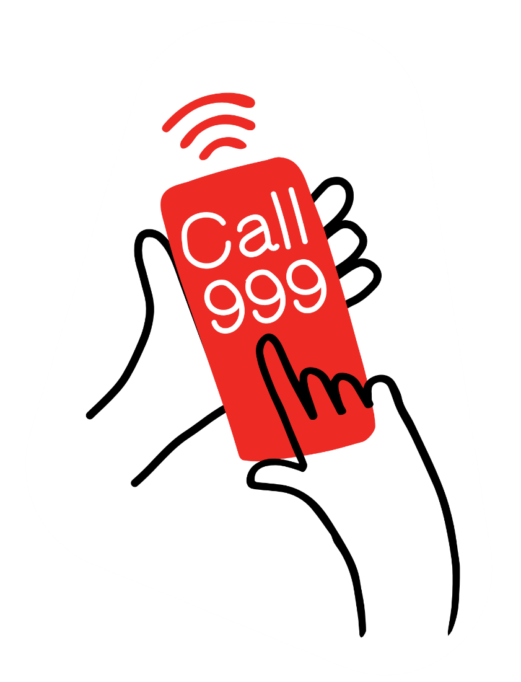
Calling 999.
Practise calling 999
Role-play cards

Slide 2
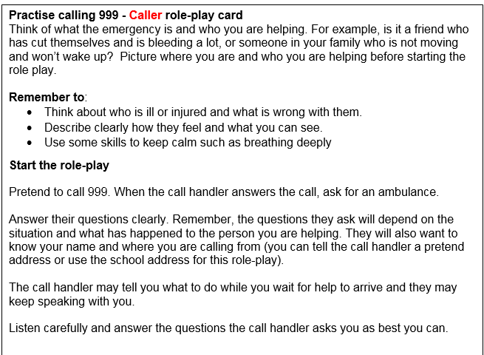


Slide 3



