Slide 1


Slide 2
Preparing for statutory RELATIONSHIPS EDUCATION
Train the Trainer RSHE 2020

Slide 3

1 Key legislation
Children and Social Work Act 2017
Final statutory guidance published June 2019.
2010 Equalities Act- Diversity and equality – need to foster
‘no outsiders in our school’
In primary schools, we want the subjects to put in place the key building blocks of healthy, respectful relationships, focusing on family and friendships, in all contexts, including online.’

Slide 4
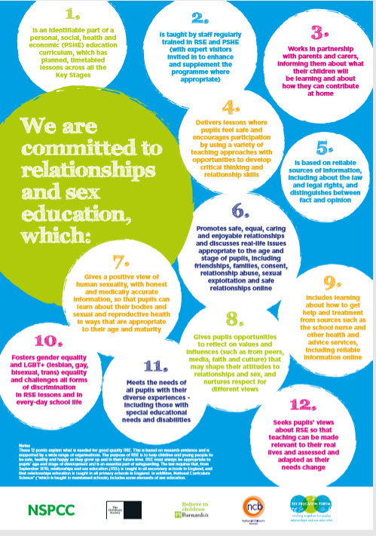
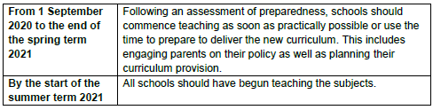
2 12 guidelines for RSE- Sex Education Forum
Inclusion – all children must feel they are represented
Latest update – June 2020
Prioritize mental health and wellbeing

Slide 5
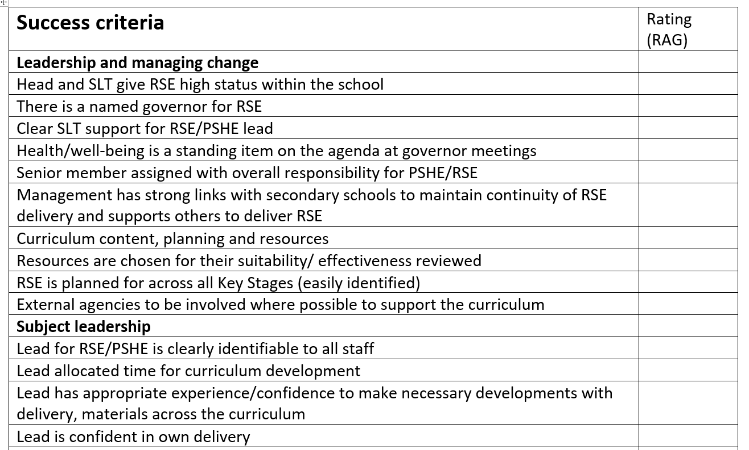
3 Assessing the need
Identify areas you are currently meeting and areas for development

Slide 6
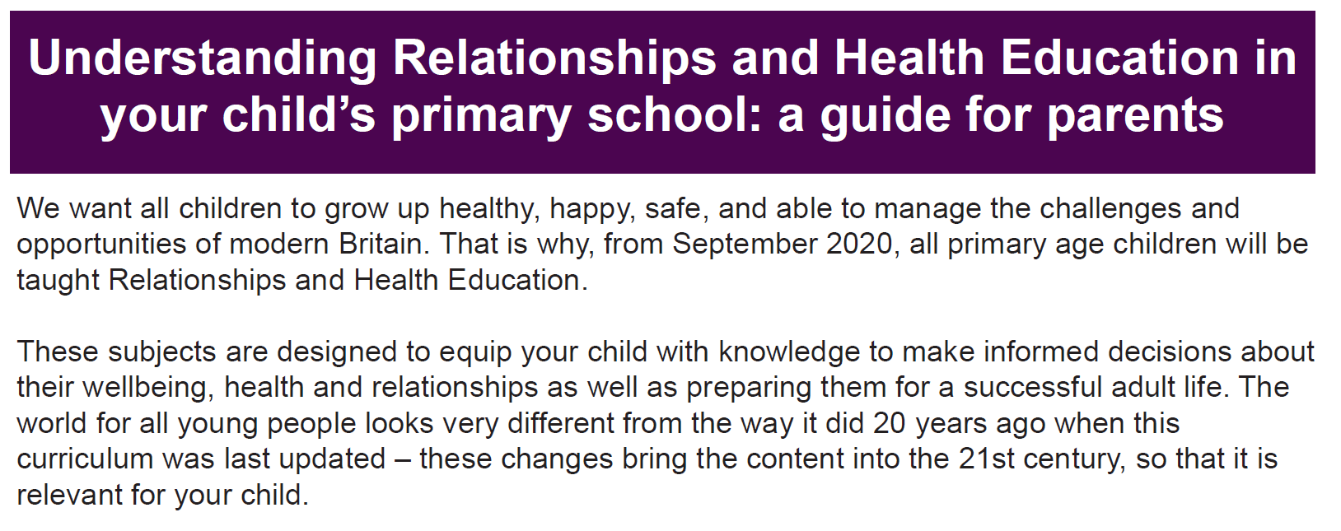
4 Engaging parents
Statutory guidance states
‘Parents should be given every opportunity to understand the purpose and content of Relationships Education and RSE. Good communication and opportunities for parents to understand and ask questions about the school’s approach help increase confidence in the curriculum’
Policy consultation e.g. working group, reviewing the policy
Parent surveys/class representatives
Virtual information evenings/ coffee mornings with focused groups

Slide 7
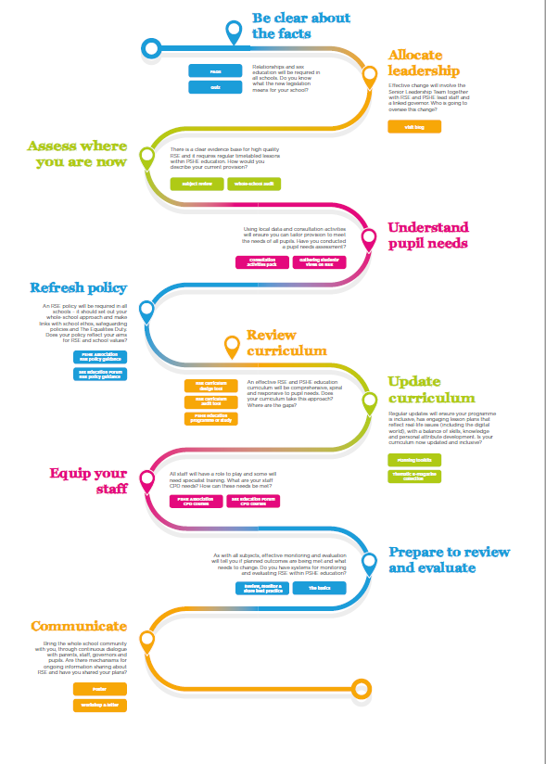
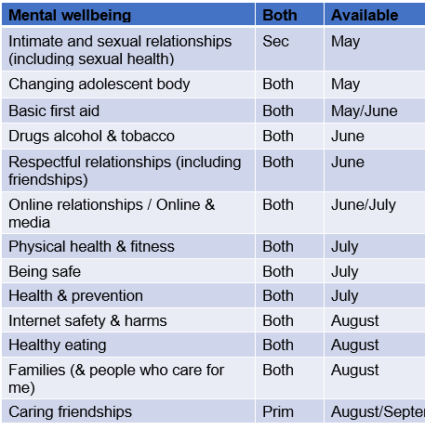
5 The roadmap to RSE 2020

Slide 8
6 How does RSE benefit pupils?
Skills to build positive, enjoyable and respectful relationships.
Learn how to stay safe both in on and offline relationships
Preparation for both physical and emotional changes of puberty

Slide 9
7 What will Relationships Education cover?
Families and people who care for me
Caring friendships
Respectful relationships
Online relationships
Being Safe

Slide 10
8 What will Health Education cover?
Mental wellbeing
Internet safety and harms
Physical health and fitness
Healthy eating
Drugs, alcohol and tobacco
Health and prevention
Basic first aid

Slide 11
9 Highlights of new curriculum
All relationships are equally valid and different types of relationships must be taught
Negotiation – being able to negotiate situations effectively . Linked to resilience (mental health)
Emotional intelligence – being able to talk about feelings and recognise changes emotionally
Recognising the need for personal space and boundaries (appropriate touch)
Correct anatomical names for body parts
Simple self-care techniques – impact of relaxation, hobbies and time with friends
Notes:
2 mins end 2 :26
Link all together – new identify unhealthy friendships and that friendships can and do end
OK not to be OK
Anatomical body parts !!!!

Slide 12






Families and people who care for me
That others’ families look different from their family but they should respect the differences.
Notes:
Spiral curriculum – learn language and content, build on that as they mature and ask age appropriate questions.
P16-17 of document lists what they should know by the end of primary.
Importance of exercise, sleep, nutrition, understanding of normal range of emotions. Hobbies, personal hygiene, basic first aid, balancing time spent off/on line
Give children the skills to talk about how they feel and develop language to talk about their health, body and emotions.
Give skills to live healthy, happily and stay safe in the 22nd century with climate change, rise of AI and mass migration

Slide 13


Being safe
Privacy and not right to keep secrets if they relate to being safe.
Each person’s body belongs to them, appropriate/inappropriate contact.
How to respond safely and appropriately to adults, ask for advice and keep trying until they are heard, where to get advice.

Slide 14

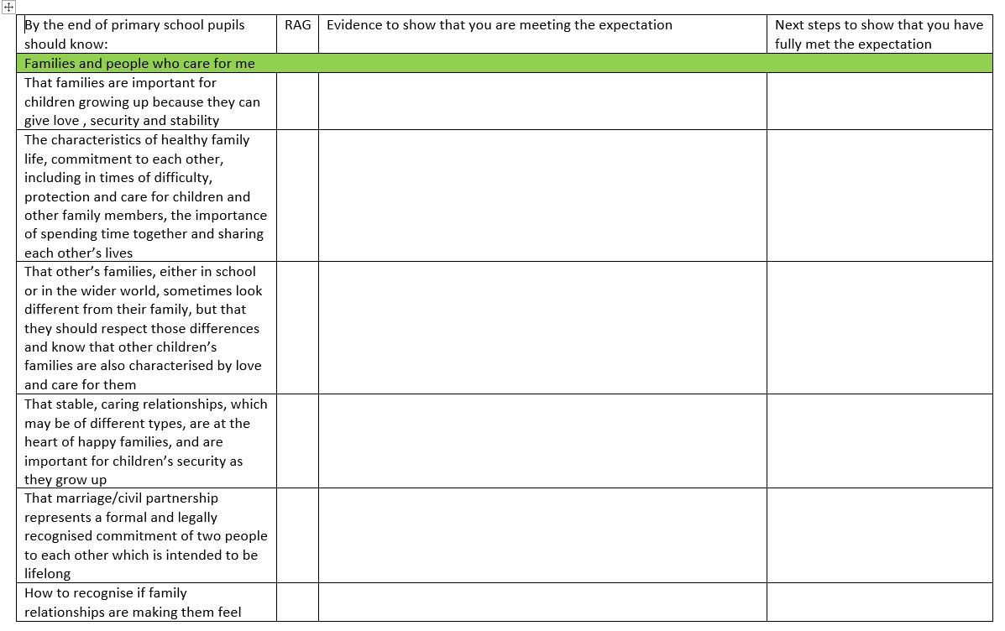
12 Review curriculum
Spiral curriculum
Age- appropriate
Responsive to pupil needs

Slide 15
13 Resources
Is it consistent with the school ethos, values framework and RSE policy?
Is it appropriate to the needs of the pupils in terms of language, images, maturity etc.?
Is it inclusive of all children and young people with respect to ethnicity, gender, sexual orientation or disability?
Does it include positive images of a range of people?
Can the resource be adapted according to different levels of understanding?

Slide 16
14 Sex Education
P67 - tailored to age and the physical and emotional maturity of pupils. Ensure pupils are prepared for changes that adolescence brings. Drawing knowledge of human life cycle set out in science curriculum
How a baby is conceived and born. IVF option.
Parents must have ‘opt-out’ option
Accessible and transparent

Slide 17
15 Policy
Define sex and relationships education
How is RSE provided and who is responsible
How the policy has been produced
Monitoring and evaluation
Regularly reviewed
Set out subject content/scheme of work and how it is taught
Clarify why parents do not have right to withdraw their child
Diversity and Inclusion
Sensitive to religious and cultural views in your school.
Ensure pupils have access to the learning they need to stay safe, healthy and understand their rights as individuals.
Clear, impartial scientific information on the changes of puberty, abortion and assisted conception.

Slide 18
16 Your staff
Staff training before they deliver RSE
Training session needs to focus on why RSE is important, the statutory guidance and safeguarding links
Areas such as Inclusion, correct anatomical names and appropriate touch need to be addressed so all staff using same vocabulary.
Awareness of curriculum content/resources
Dealing with difficult situations

Slide 19
17 Difficult questions
Ground rules
Distancing techniques
Stock agree answers
Plan/rehearse lesson
Be aware of sensitivities with issues covered
Take time to come back to difficult questions

Slide 20
18 Right to withdraw
Not able to withdraw their child from any aspect of RSE or Health education (including learning about the changing adolescent body and puberty)
Can withdraw their child from any aspects of Sex Education other than those which are part of the science curriculum.
Can parents withdraw if they do not want their child to learn about equality and diversity, LGBT+ inclusion? NO

Slide 21
19 Monitor and evaluate
Monitoring | Evaluation
Ongoing –checks implementation of scheme | Measures lesson/unit of work is effective
Is the programme effectively managed and are staff clear about their roles/responsibilities? | Has this lesson enabled pupils to learn what was intended?
Does it reflect national guidance/priorities? | Does it meet the needs of the pupils?
Are all pupils being taught as planned? | What do teachers and pupils think of it? Good/bad points
Is quality of teaching consistent? Is it best practice? | Do we need to modify/improve it?

Slide 22

20 Inclusion
Schools should ensure that all of their teaching is sensitive and age appropriate in approach and content and how to teach their pupils about LGBT (not just one stand alone lesson).
Questions to consider-
Am I visible?
Can I access the learning?
Does it meet my needs?
Is it about me?

Slide 23
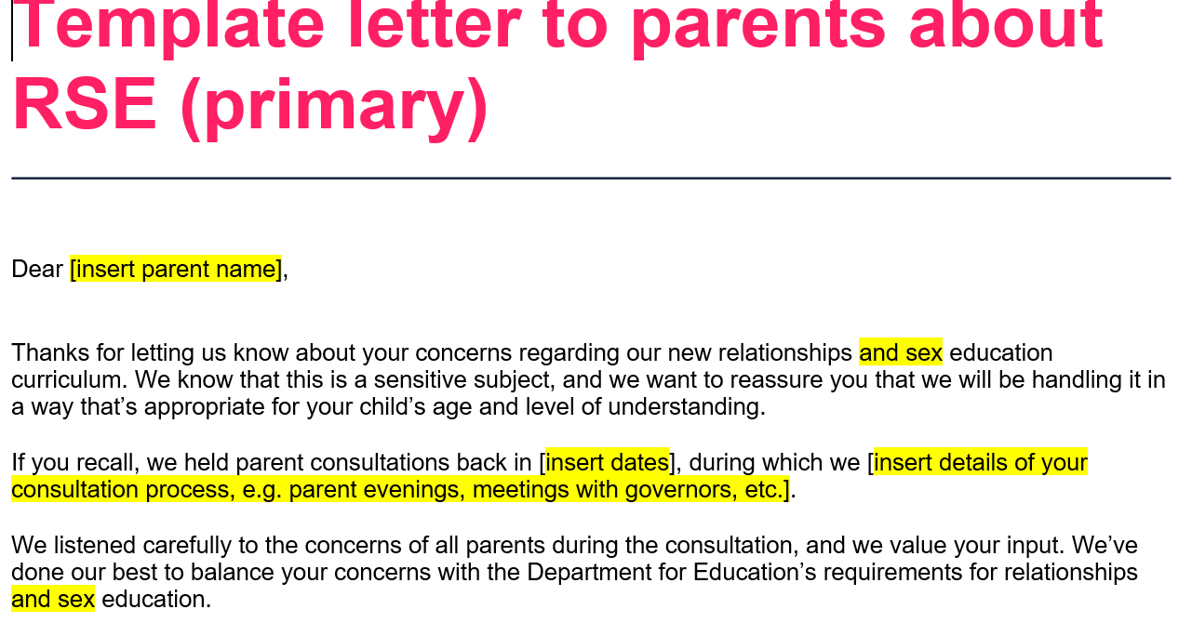
21 Handling parent complaints
‘’My child is too young for sex education’’
‘’Homosexuality is a sin and I don’t want you to teach my kids it is okay’’
‘’The language is not appropriate for my child in Year 1’’
Handle objections informally first.
Use letter to explain curriculum design.
Ask them to come in for further reassurance to speak to you in person.

Slide 24
To summarise:
Latest government guidance about implementation – phased approach
Guidance on RSE
Staff needs
Meeting parent needs
MUST :
Policy in place before delivering content
Consultation with parents
Inclusion – Transparent/Accessible
Curriculum content (end of primary learning targets)
Parent withdrawal- statutory status
Even better if’s:
Pupil voice – curriculum
Consulted staff

Slide 25

Next training session: Mental wellbeing
Tuesday 7th July 3:30-4:30
https://www.eventbrite.co.uk/e/mental-health-and-wellbeing-training-module-webinar-tickets-108829493946?ref=estw

Slide 26
Q & A
Tracy Okuma
RSE/PSHE Lead
Surrey South Farnham Teaching School
rshe@sfet.org.uk

