Slide 1
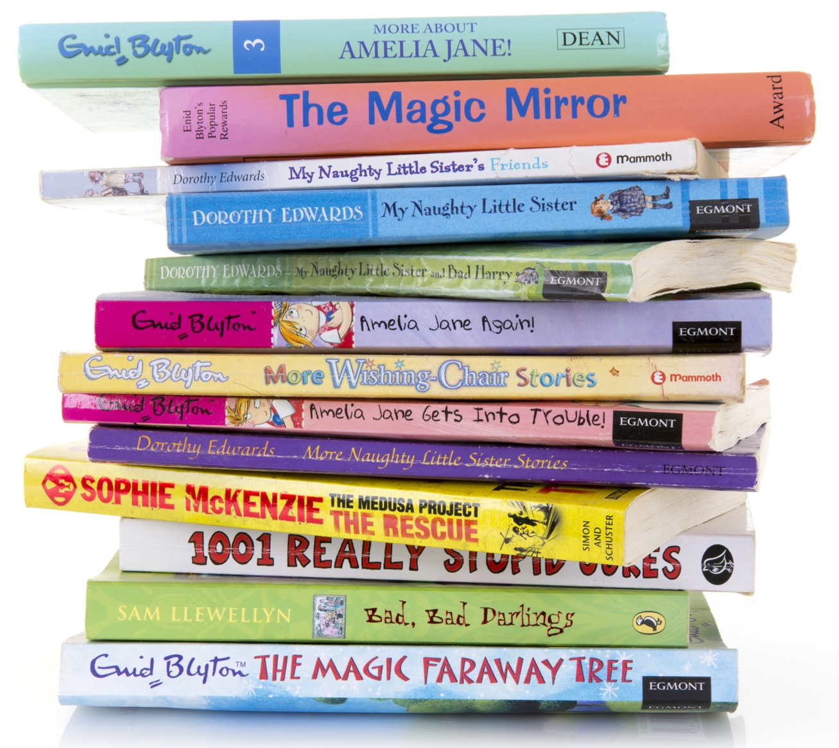
Books about families
Look at the books in your classroom which are about families.
How are these families different?
How are they
the same?
Notes:
There are some recommended books on families in the Introduction section. Some useful search terms for suitable books being read online are ‘the family book online video’ and ‘diverse families KS1’.

Slide 2
Time for a game!
Stand up.
Your teacher will read out a description of someone who might be in your family.
If the description matches someone in your family, sit down.
Notes:
Suitable statements include: Sit down if someone in your family drives a blue car, has ginger hair, has a bald head, likes to garden, enjoys swimming. The statements need to be quite generic as some pupils will be thinking of extended family too.

Slide 3
You are the author
Create a picture book showing all the things that can be different about a family and all the things which are the same.
You could start your sentences with:
Some families like to …
Or:
Some families have …
Then:
All families like to …
Notes:
Encourage pupils to think about the fact that some families have more than one mum or dad, or have step-parents or siblings, or are from a single-parent family, foster home or care home where there might be lots of children.
Some of the things which all families like to do are: spend time with each other, love each other, help each other, care for each other, have fun together and laugh.

Slide 4
Story-telling time
Share your story with the class.
Notes:
Reiterate the key points from the lesson about diversity in families and highlight key examples of this from the pupils’ work.

