Slide 1
Different Families
LO: to understand diversity in families

Slide 2
What is a family?

Slide 3
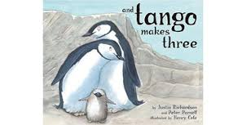
Story Time!
What was different about Tango’s family compared to the other penguins’?
Lots of people have two daddies, or two mummies.
Notes:
https://www.youtube.com/watch?v=WyPjUa908hM

Slide 4
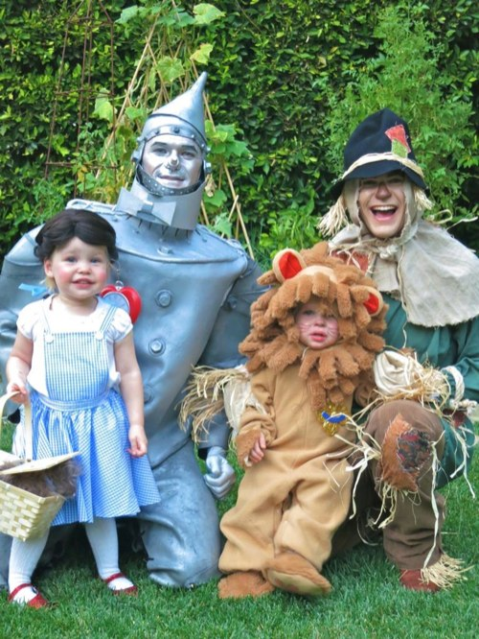
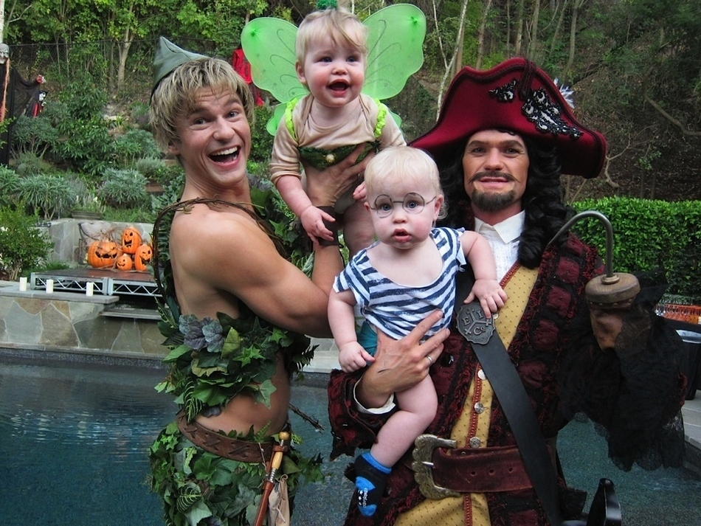
Gideon and Harper’s daddies are a bit like Tango’s! They’re gay- two men in love with one another. The family like to dress up for Halloween- can you guess who they are in these photos?

Slide 5
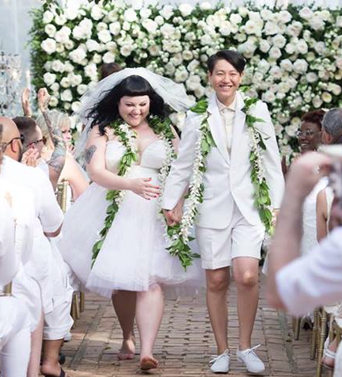
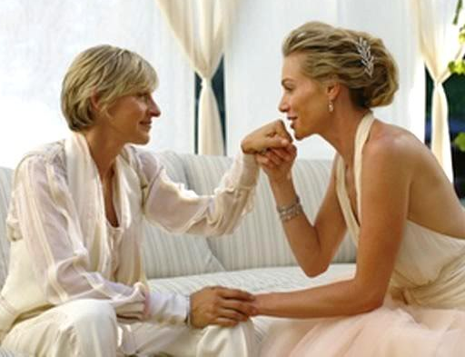
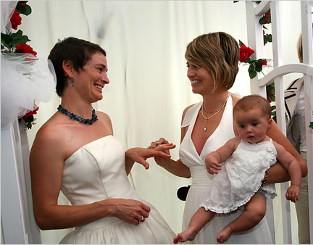
Monty’s mummy is a lesbian- a woman in love with another woman. They’re getting married. There will be a big wedding and a party afterwards!

Slide 6
All families are different!

Slide 7
Your turn!
Draw a picture of your family.
Spot the difference! On your table, count the ways your families are different from one another.
What other differences can we think of?

Slide 8
Changing Families
Families don’t always stay the same

Slide 9
Emma’s grandma lives alone She gets lonely, so she’s moving in with Emma and her parents.
Charlie’s big brother is going away to university. He’ll be living in another town except for holidays.
Changes can sometimes be scary. How might Charlie, Amber or Shay feel? How might Emma’s granny feel? What advice would you offer them?
Amber’s mummy is pregnant. Amber’s been an only child all her life, but now she’s going to be a big sister!
Shay’s parents are getting a divorce. This is when two people decide they don’t want to be married any more.

Slide 10
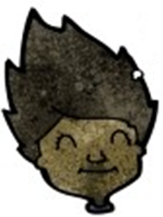
Sam has a big announcement for the family:
Sam’s family are very proud of her. It’s very brave to be honest about who you are.
They might have questions, and that’s okay. But from now on, they’ll call her by her chosen name, and use “she” pronouns.
I’m transgender.
It makes me very sad to be a man. It’s just not me. No one should be forced to be someone they’re not
When I was born, the doctors said I was a boy.
But I feel like they made a mistake- I’m actually a woman.

Slide 11
Respect
How can we respect one another’s families?
We celebrate our differences
We don’t make fun of other people’s families
If we want to ask questions, we are polite, and accept that the other person has the right not to answer
We understand that changes can sometimes be scary and we look after one another

Slide 12
What Makes My Family Special
Who do you live with?
What do you do together?
How has your family changed?
What’s your favourite thing about your family?

Slide 13


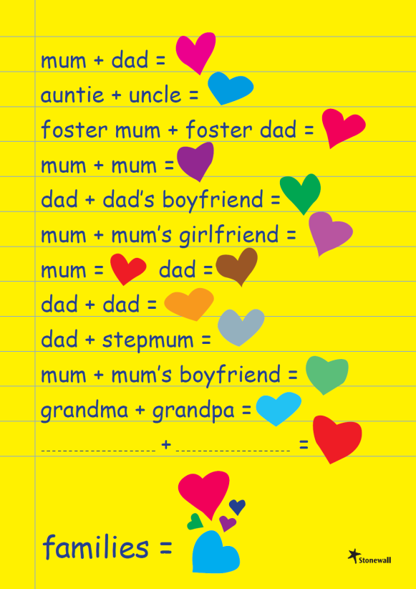
How are families alike?
Respect
LOVE
CARE
Notes:
Posters available in print form via Stonewall, as well as postcards and stickers. (Free of charge in small quantities)

