Slide 1
Religion and human relationships | SYLLABUS OUTLINE- TERM AHEAD.
Roles of men and women in the family | Roles of men and women in a Hindu family Roles of other family members according to the demands of varnashramadharma and the scriptures
Marriage and marriage ceremonies | Marriage ceremonies in the UK and India The symbolism and the meaning of the various features of the ceremonies. The ways in which the ceremonies reflect and emphasise Hindu teaching about marriage. Responses to Civil Partnerships
Divorce | Beliefs about the ethics of divorce in India and the UK. Beliefs about the ethics of re-marriage in India and the UK.
Sexual relationships and contraception | Attitudes towards sexual relationships as they relate to varnashramadharma and kama as a valid life goal during the grihastha ashrama. Teachings about celibacy and renunciation including the tapas and the teachings of MK Gandhi. Beliefs about contraception, including the idea of ahimsa. Social concerns about contraception
SYLLABUS
OVERVIEW

Slide 2
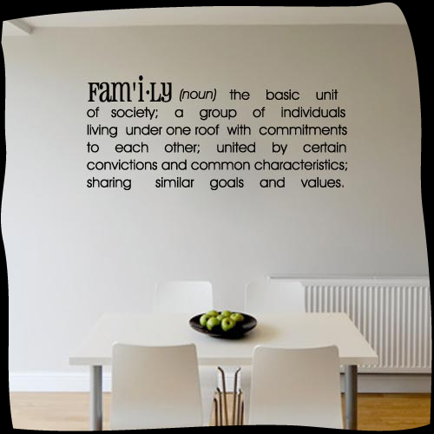
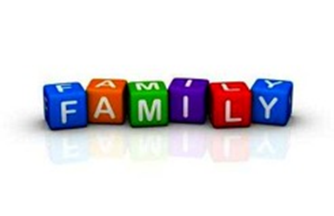
What is meant by the term family?
(1 mark)
Work in pairs to write an answer to this question….

Slide 3
Learning Intentions
To understand syllabus outline for this unit
To be able to understand how the roles and structure of the family unit have changed over time.
Awareness of different types of family.
The purpose of family.
Hindu teachings about the family
Next week
Ashramas-
Stages of life and
Duty in the family
Roles of men and women in Hindu Family
‘Women need to follow
traditional roles if families are to be successful’ Discuss.
Key question for next 3 weeks!

Slide 4
How the roles and structure of the family unit have changed over time.
Think about family life in 1913 how have families changed by 2013?
Over 100 years in what ways has the structure of families and family values in the UK changed?

Slide 5


Match the following words, definitions
Nuclear Family
A family that involves wider network of relatives, blood relatives, such as Grandparents, cousins, uncles living as a unit
Reconstituted or blended family
A family made up of step brothers and sisters, two families united after divorce, with a new step Mother or Father
Extended Family
A family cared for by one Parent, usually Matrifocal,
Led by women- but not always.
Compound family
Legal union of a same sex relationship
A group of people living together, not related by blood but are have a shared purpose.
Single parent family
Immediate family of 2 Parents and theirchildren living together- close blood ties- conjugal family.
Civil partnerships

Slide 6
Match the following words, definitions
Nuclear Family
Immediate family of 2 Parents and theirchildren living together- close blood ties- conjugal family.
Reconstituted or blended family
A family made up of step brothers and sisters, two families united after divorce, with a new step Mother or Father
Extended Family
A family that involves wider network of relatives, blood relatives, such as Grandparents, cousins, uncles living as a unit
Compound family
A group of people living together, not related by blood but are have a shared purpose.
Single parent family
A family cared for by one Parent, usually Matrifocal,led by women- but notalways.
Civil partnerships
Legal union of a same sex relationship

Slide 7
Draw a Timeline to show change in family values over time
Use the different types of families we have discussed to show on your
timeline how family values have changed, discuss changing role of women, increase in divorce, cost of bringing up a family, change in attitudes to marriage to explain how families have changed.
Past
present
Your homework will be to add to this and find a couple of newspaper articles that discuss the changing role of family values.

Slide 8
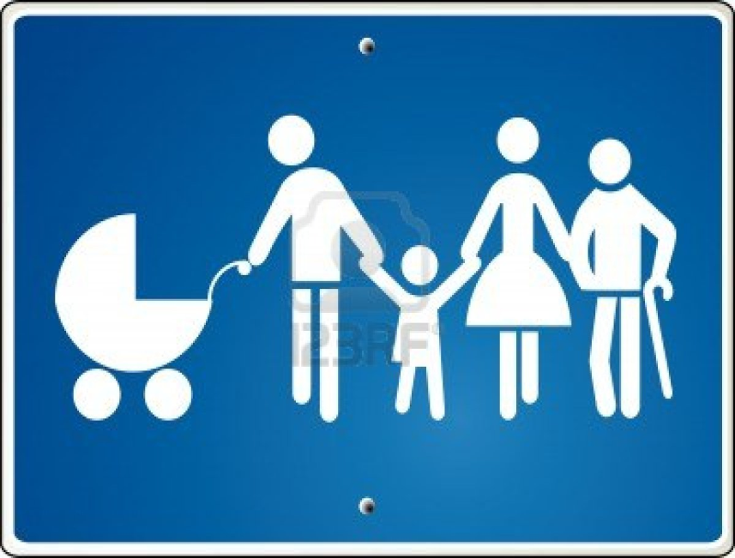
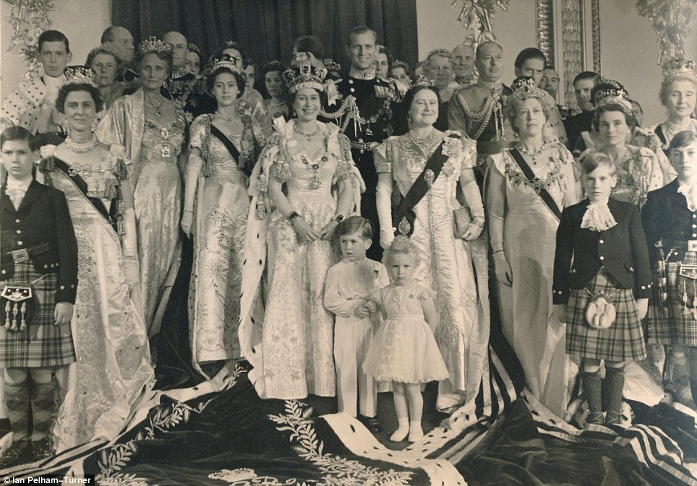
1.What type of family is this
2. Does this relate to family values from the past or present?
3.On your timeline explain why families in the past lived as an extended family- why are there less extended families today?
EXTENDED FAMILIES

Slide 9
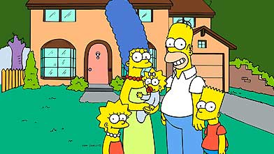
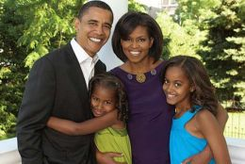
1.What type of family is this
2. Where will it go on your chart in the past or present?
3.Can you explain why modern families are more likely to be nuclear families.
4.What are the benefits of this type of family?
Nuclear Family

Slide 10
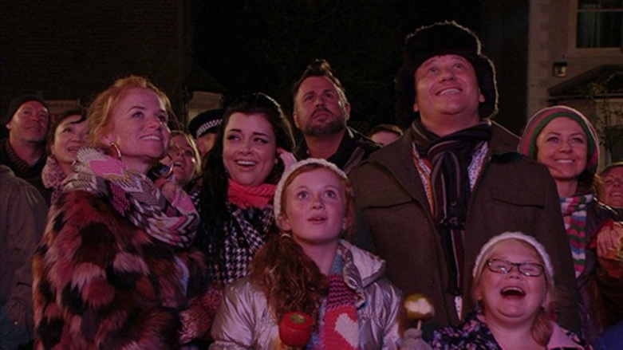
Blended- Reconstituted Families
1.What type of family is this
2. Traditional or modern view of family life?
3.Why has there been an increase in Reconstituted families?

Slide 11
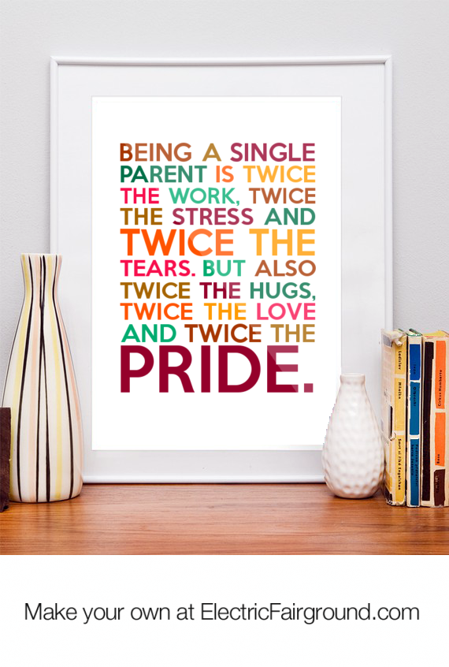

What type of family is this?
Where does it go on your timeline?
Why are single parent families on the increase?
How does this show a change in family values over time?

Slide 12
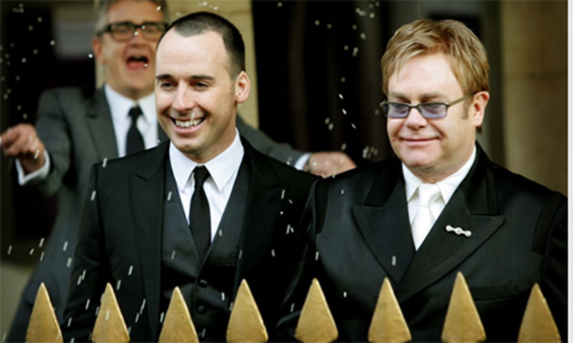
Same sex relationship
Civil Partnership
1.What type of family is this
2. Where will it go on your chart in the past or present?
3. Is a Civil Partnership the same as a marriage?

Slide 13
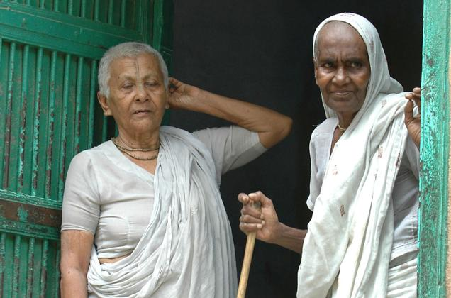
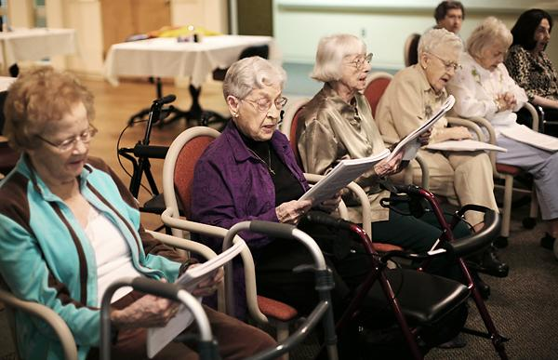
1.What type of family is this
2. Where will it go on your timeline in the past or present?
3. Have compound families always existed?
4. Why have the decline in extended families led to the need for old peoples homes?
5. What questions do you have about the 2 Hindu widows?
Compound families

Slide 14


Types of relationships- match definitions
Monogamy
also called in-marriage and is the custom of marrying within one's cultural group or clan.
The practice or condition of having a single sexual partner during a period of time. The practice or condition of being married to only one person at a time. The practice of marrying only once in a lifetime
The condition or practice of having more than one spouse at one time. Also called plural marriage.
cohabitation
Same sex relationship
endogamy
A relationship involving the opposite sex-
Male and female
polygamy
Term given to couples living together but not married

Slide 15
Types of relationships- match definitions
The practice or condition of having a single sexual partner during a period of time. The practice or condition of being married to only one person at a time. The practice of marrying only once in a lifetime
Monogamy
A relationship involving the opposite sex-
Male and female
Same sex relationship
Term given to couples living together but not married
cohabitation
endogamy
also called in-marriage and is the custom of marrying within one's cultural group or clan.
polygamy
The condition or practice of having more than one spouse at one time. Also called plural marriage.

Slide 16
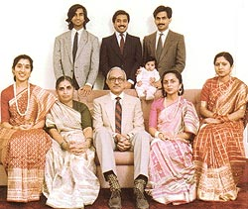
HINDU FAMILY VALUES
Work in pairs look at the words we have used so far- which would best sum up the views of Hindus on family?
Why?

Slide 17
Purpose and function of a Hindu Family?
The women collectively share household responsibilities, and the men provide the pooled income.
The basic building block of Hindu society is the joint or extended family
When women marry, they usually join their husband's family, though maintaining contact with their own.
The extended family traditionally provides shelter and support for the elderly, the disabled and the less well off
Use these ideas to explain 3 good reasons why Hindus have extended families
Children are expected to repay the debt owed to their parents by supporting them in their retirement and old age
Elders take important decisions and, based on their own experience in life, offer guidance to younger members
Within the family, property usually passes from father to son, and men make many of the decisions

Slide 18
Set up the following chart- on a double page- use the whole double page
 | In the past in UK | Current attitudes in UK | Hindu responses
Family Values
Marriage
Divorce
Sexual Values
You will fill this in over the next few lessons-

Slide 19
“Bad parents are to blame for society’s ills”
Bad parents are to blame for society’s ills, says Ofsted chief: Sir Michael Wilshaw attacks 'hollowed out and fragmented families'
Oftsed chief inspector said child abuse and neglect were the product of social breakdown
Sir Michael described 'national obsession with pussyfooting around'
The former school principal named Birmingham as one of the worst places to grow up in the developed world
By Steve Doughty
PUBLISHED: 00:40, 16 October 2013 | UPDATED: 00:52, 16 October 2013
Read more: http://www.dailymail.co.uk/news/article-2462110/Sir-Michael-Wilshaw-attacks-hollowed-fragmented-families.html#ixzz2l6rmtf1h
Follow us: @MailOnline on Twitter | DailyMail on Facebook
HOMEWORK READ THIS ARTICLE AND EXPLAIN YOUR THOUGHTS- FIND ANOTHER ARTICLE ABOUT FAMILY VALUES IN UK TODAY

