Slide 1
Are you keeping safe?
E-safety

Slide 2
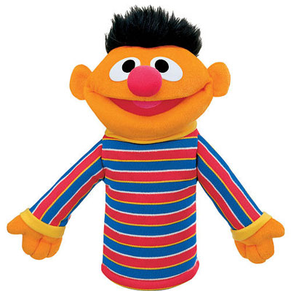
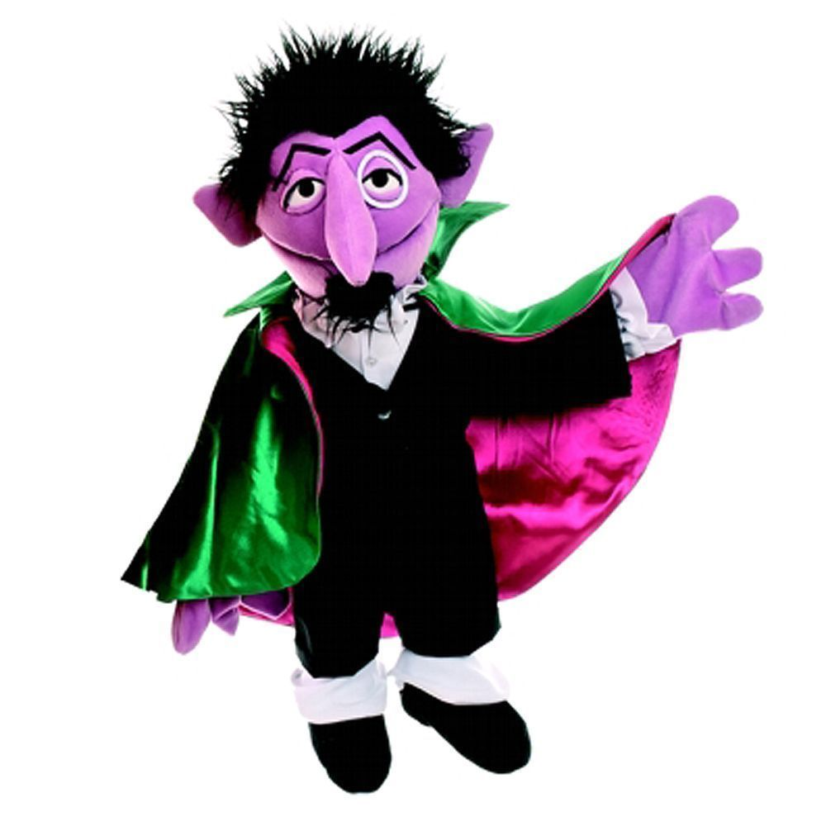
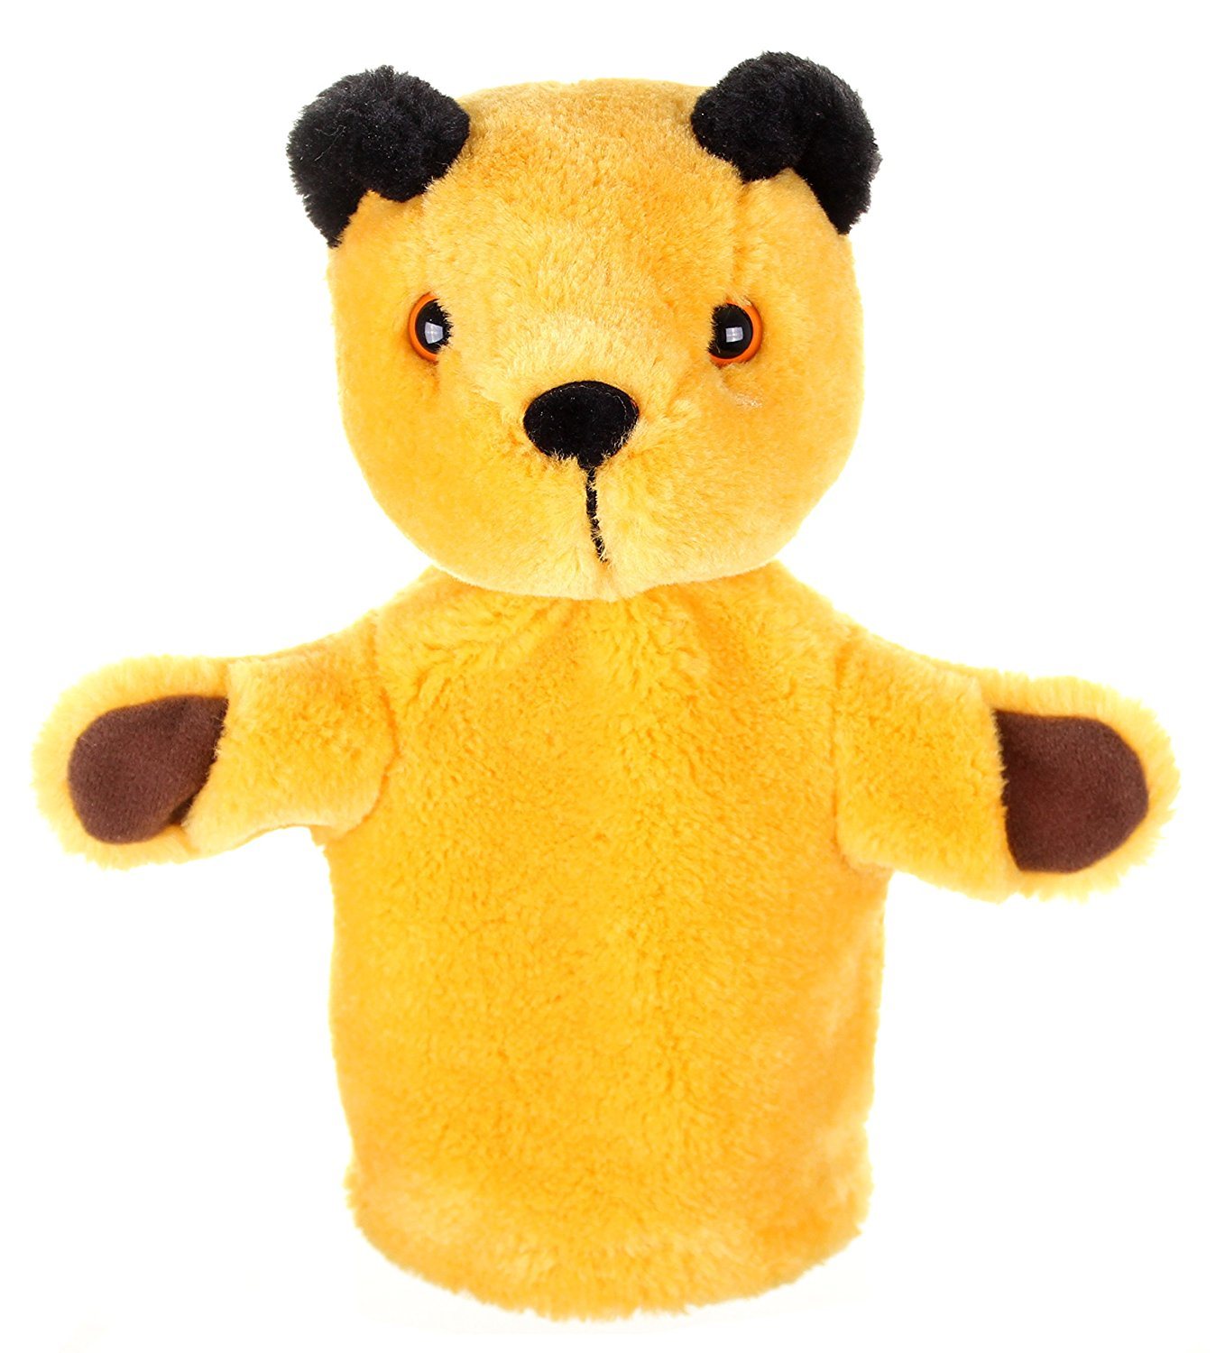
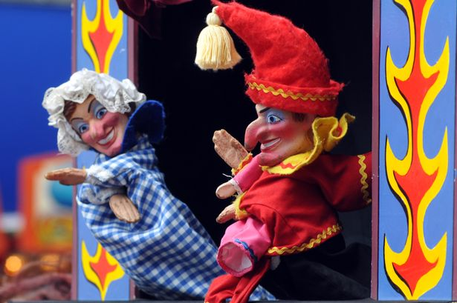
Puppets
When somebody is performing a puppet show they make up a name for the puppet and make up stories to tell us.
The stories are not true. Puppet shows can be really funny.
Talk partners:
What puppets do you know and/or like?

Slide 3
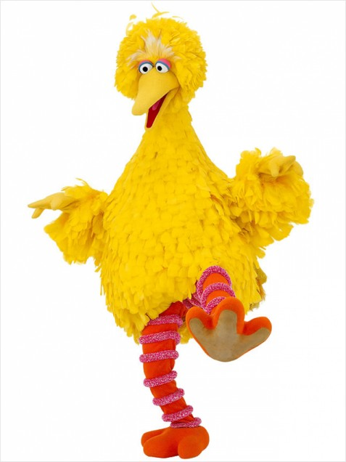
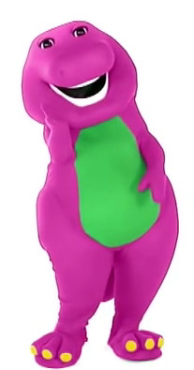
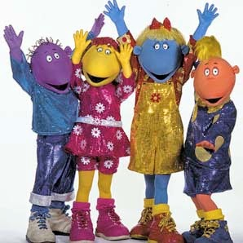
Dressing up
When people are dressed up they are really funny, and probably very hot in their costume!
Talk partners:
Do you like to dress up?
What do/would you dress up as?

Slide 4
Important message
When talking to puppets or characters in costumes…
do you really know WHO you are talking to?

Slide 5
Strangers
What does a stranger look like?
Do all dangerous people look the same?
Can we tell by looking at someone whether we could be in danger?

Slide 6



Internet safety
When you talk to somebody on the internet, or social media – can you see the person talking or typing to you?
Are they like puppets or dressed up characters?

Slide 7


Internet safety
When you talk to somebody on the internet, or social media – do you really know them?
Are they strangers?

Slide 8
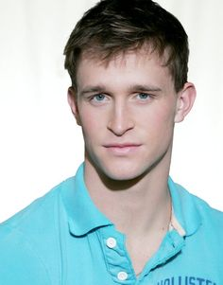
Profiles
Tell me what you know about the person in this profile…

Slide 9

No! A girl who is 18 years old and who lives in America is using this photo to deceive her friend!

Slide 10

Profiles
Tell me what you know about the person in this profile…

Slide 11
No! A man who is 63 is using this picture to find young people.

Slide 12
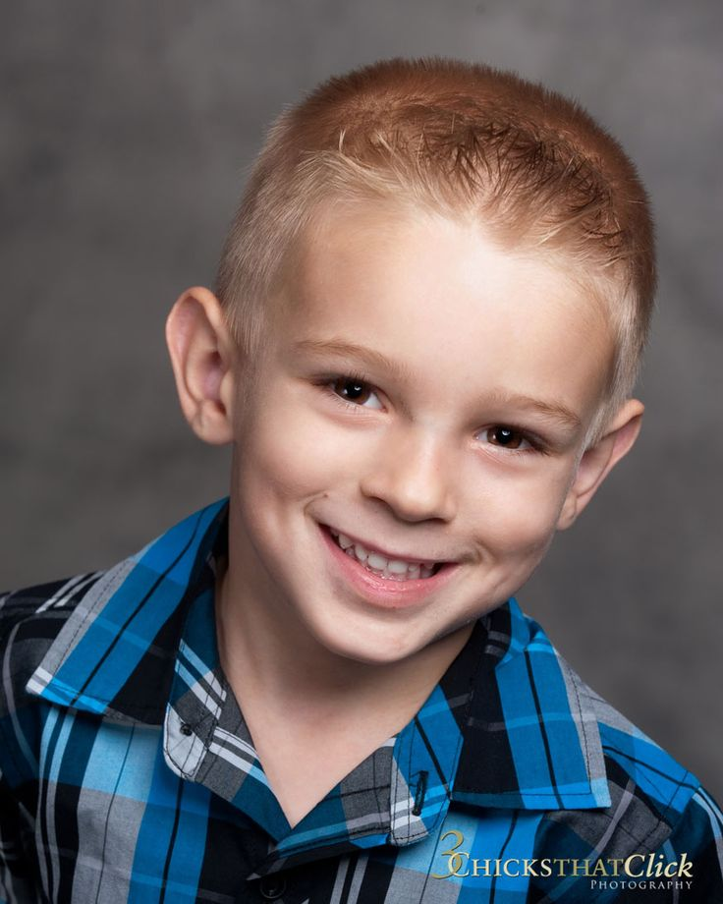
Profiles
If you received a message with this picture, should
you trust them more?

Slide 13
No! A woman is pretending to be this little boy to trick children and try to meet them!

Slide 14

Stay suspicious, stay safe!
Keep your mind and your eagle eyes open and always protect yourself.
Some people lie and steal other peoples pictures or information so that they can trick you. They think it is easiest to trick you because you cannot really see them.
Strangers all act and look different, so always be on guard.
Be honest to your family about what you see, do and who you talk to, on the internet.
Talk to your family and your school if you are ever worried.

