Slide 1



Presented by [insert class name]

Slide 2

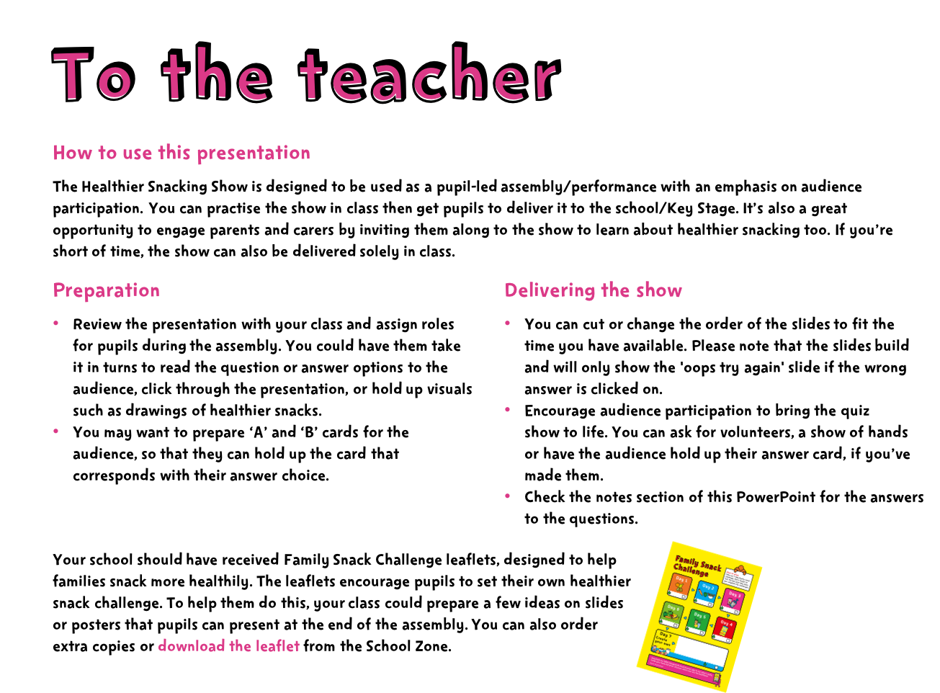

Notes:
Family Snack Challenge leaflets will be delivered with the School Fruit and Veg Scheme during January 2018.
The leaflets can also be downloaded here: https://campaignresources.phe.gov.uk/schools/resources/Family-snack-challenge-leaflet

Slide 3
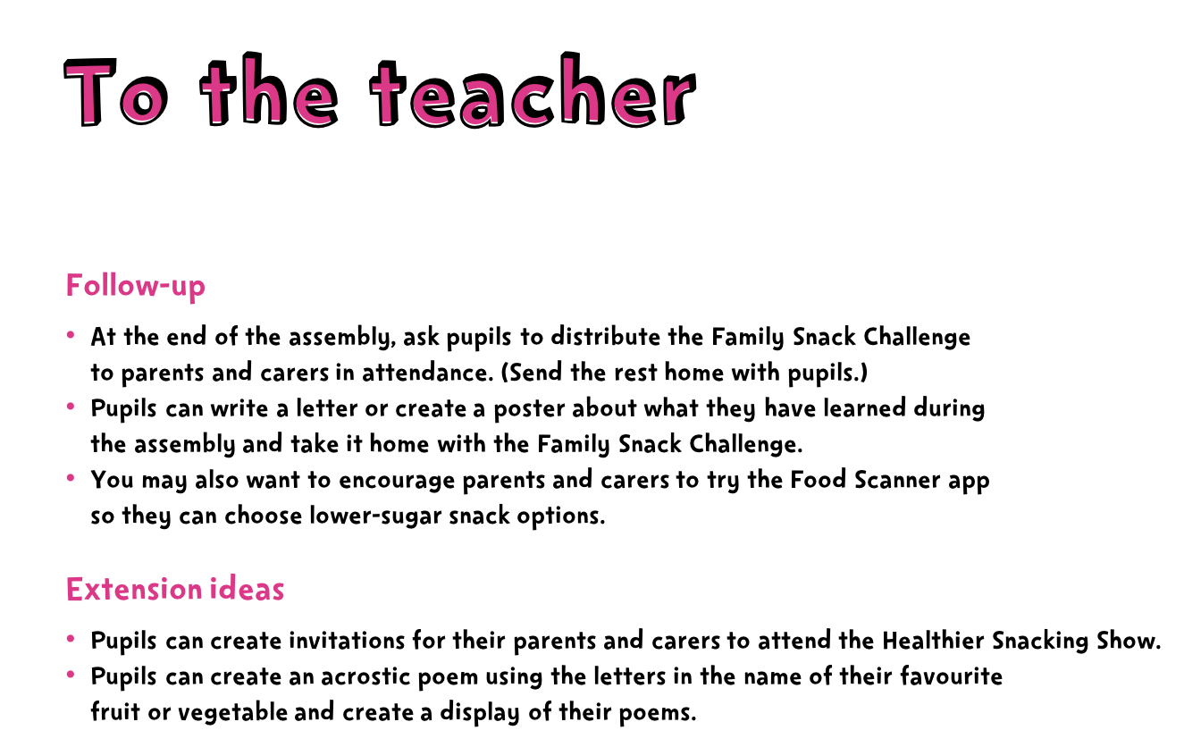

Slide 4





Slide 5

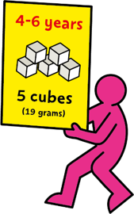
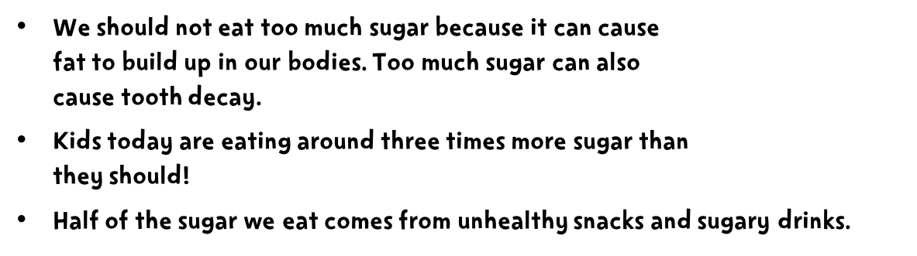

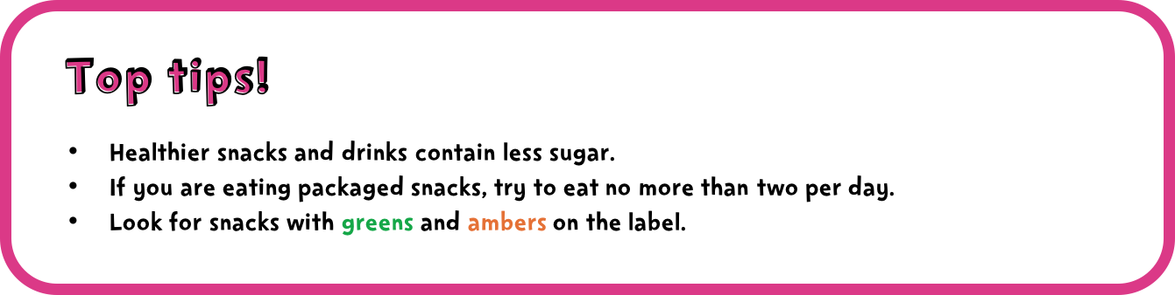
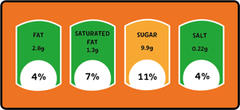


Notes:
1 cube = 4g sugar
You could present the key facts and top tips in various ways:
create a short role play scenario where one pupil learns about the key facts
you could bring in a few packaged snacks with the traffic light system on the label to demonstrate what to look for.
Remember that fresh fruit and vegetables, plain milks and plain natural yoghurts all contain ‘intrinsic sugars’, which we don’t need to worry about. 5 A Day guidance specifies that dried fruit and fruit juice, vegetable juice and smoothies are not suitable to be consumed between meals due to dental concerns.
For more information, see the EatWell guide: https://campaignresources.phe.gov.uk/schools/resources/eatwell-guide

Slide 6


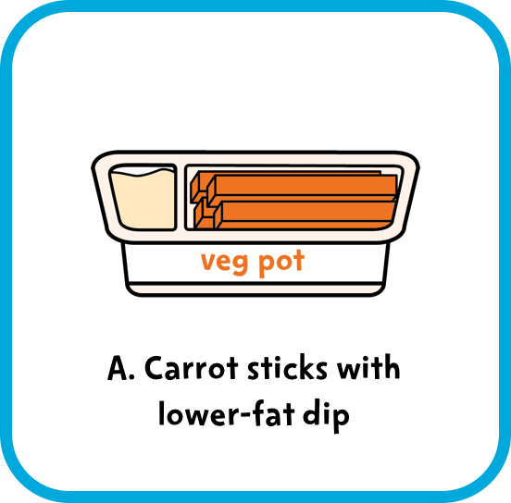



Notes:
Answer: A. Carrot sticks with lower-fat dip
Fruit and veg are a great choice for snacks. Biscuits can contain lots of added sugar and saturated fat so we shouldn’t eat them often.
Encourage audience participation. After a pupil reads out the question/answer options, they could choose a volunteer to answer, ask for a show of hands, or audience members could hold up the A or B card according to their guess.
Remember that fresh fruit and vegetables, plain milks and plain natural yoghurts all contain ‘intrinsic sugars’, which we don’t need to worry about. 5 A Day guidance specifies that dried fruit and fruit juice, vegetable juice and smoothies are not suitable to be consumed between meals due to dental concerns.
For more information, see the EatWell guide: https://campaignresources.phe.gov.uk/schools/resources/eatwell-guide

Slide 7



Slide 8
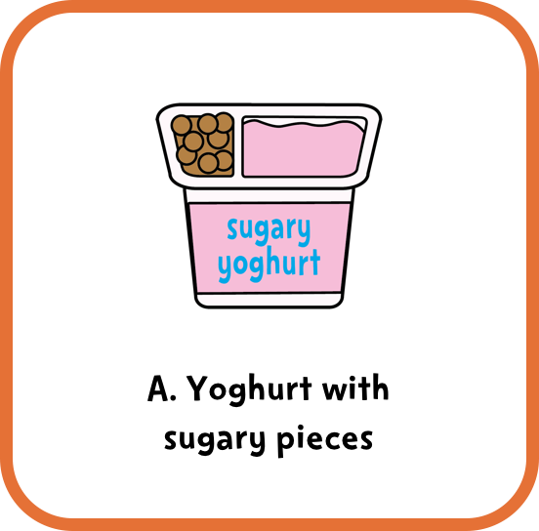
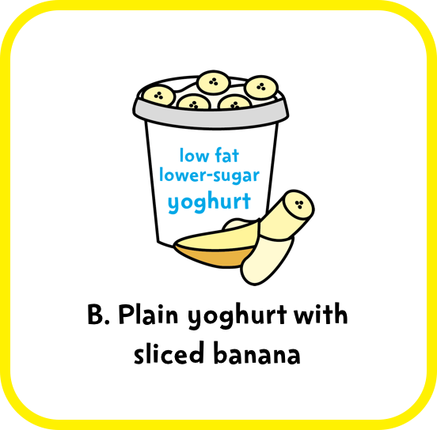

Notes:
Answer: B. Plain yoghurt with sliced banana.
Fresh fruit and vegetables, plain milks and plain natural yoghurts all contain ‘intrinsic sugars’, which we don’t need to worry about. But sugary yoghurts can contain lots of added sugar so choose low fat, lower-sugar yoghurts instead.
Encourage audience participation. After a pupil reads out the question/answer options, they could choose a volunteer to answer, ask for a show of hands, or audience members could hold up the A or B card according to their guess.
5 A Day guidance specifies that dried fruit and fruit juice, vegetable juice and smoothies are not suitable to be consumed between meals due to dental concerns.
For more information, see the EatWell guide: https://campaignresources.phe.gov.uk/schools/resources/eatwell-guide

Slide 10
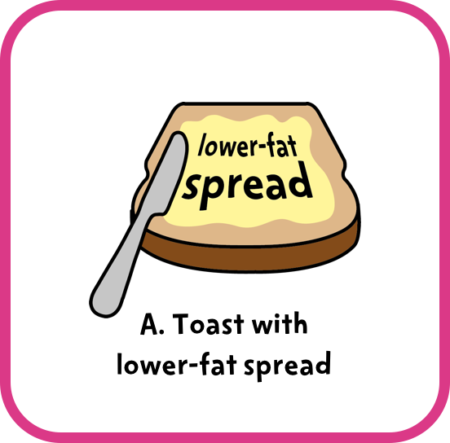



Notes:
Answer: A. Toast with lower-fat spread.
Chocolate chip muffins can contain lots of added sugar and saturated fat so we shouldn’t eat them often.
Encourage audience participation. After a pupil reads out the question/answer options, they could choose a volunteer to answer, ask for a show of hands, or audience members could hold up the A or B card according to their guess.
Remember that fresh fruit and vegetables, plain milks and plain natural yoghurts all contain ‘intrinsic sugars’, which we don’t need to worry about. 5 A Day guidance specifies that dried fruit and fruit juice, vegetable juice and smoothies are not suitable to be consumed between meals due to dental concerns.
For more information, see the EatWell guide: https://campaignresources.phe.gov.uk/schools/resources/eatwell-guide

Slide 12

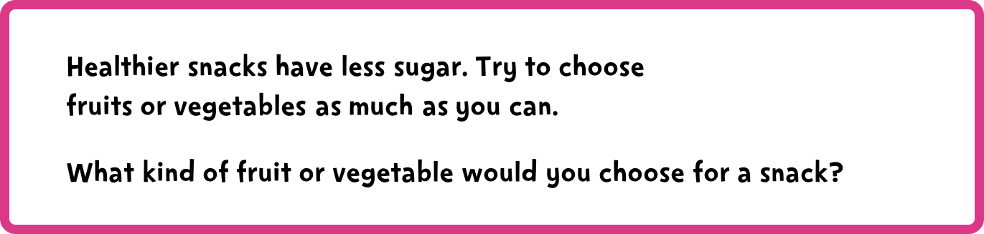






Notes:
This reinforces the key message. If you have the Food Scanner app, pupils could demonstrate it to the audience.

Slide 13


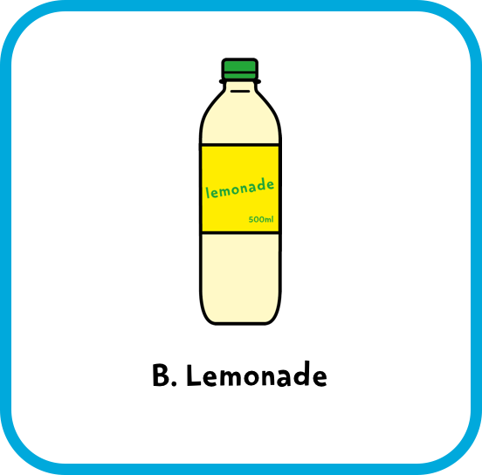
Notes:
Answer: A. Lower-fat milk
Lemonade can contain lots of added sugar so we shouldn’t drink it often. Choose plain water, lower-fat milks or diet, sugar-free, or no-added sugar drinks.
Encourage audience participation. After a pupil reads out the question/answer options, they could choose a volunteer to answer, ask for a show of hands, or audience members could hold up the A or B card according to their guess.
Remember that fresh fruit and vegetables, plain milks and plain natural yoghurts all contain ‘intrinsic sugars’, which we don’t need to worry about. 5 A Day guidance specifies that dried fruit and fruit juice, vegetable juice and smoothies are not suitable to be consumed between meals due to dental concerns.
For more information, see the EatWell guide: https://campaignresources.phe.gov.uk/schools/resources/eatwell-guide

Slide 15
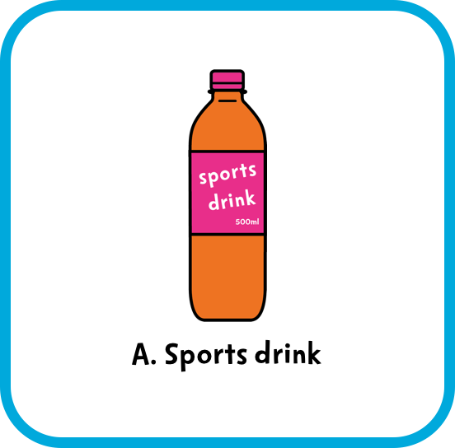
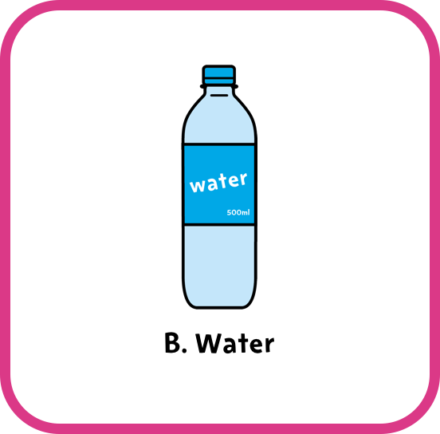
Notes:
Answer: B. Water
Sports drinks can contain lots of added sugar so we shouldn’t drink them often. Choose plain water, lower-fat milks or diet, sugar-free, or no-added sugar drinks.
Encourage audience participation. After a pupil reads out the question/answer options, they could choose a volunteer to answer, ask for a show of hands, or audience members could hold up the A or B card according to their guess.
Remember that fresh fruit and vegetables, plain milks and plain natural yoghurts all contain ‘intrinsic sugars’, which we don’t need to worry about. 5 A Day guidance specifies that dried fruit and fruit juice, vegetable juice and smoothies are not suitable to be consumed between meals due to dental concerns.
For more information, see the EatWell guide: https://campaignresources.phe.gov.uk/schools/resources/eatwell-guide

Slide 17
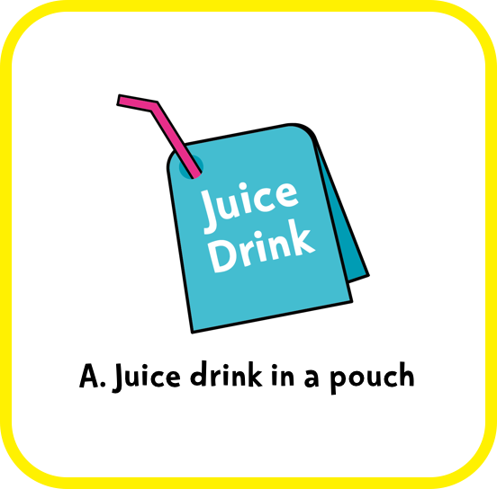
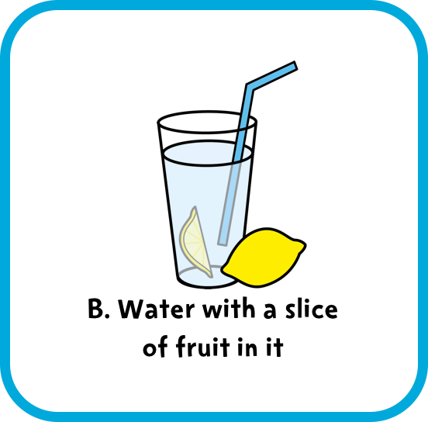
Notes:
Answer: B. Water with a slice of fruit in it.
Juice drink in a pouch can contain lots of added sugar so we shouldn’t drink it often. Choose plain water, lower-fat milks or diet, sugar-free, or no-added sugar drinks.
Encourage audience participation. After a pupil reads out the question/answer options, they could choose a volunteer to answer, ask for a show of hands, or audience members could hold up the A or B card according to their guess.
Remember that fresh fruit and vegetables, plain milks and plain natural yoghurts all contain ‘intrinsic sugars’, which we don’t need to worry about. 5 A Day guidance specifies that dried fruit and fruit juice, vegetable juice and smoothies are not suitable to be consumed between meals due to dental concerns.
For more information, see the EatWell guide: https://campaignresources.phe.gov.uk/schools/resources/eatwell-guide

Slide 19






Notes:
This reinforces the key message. Pupils could include a demonstration for the audience of the amount of sugar in two bottled drinks using the Food Scanner app.

Slide 20

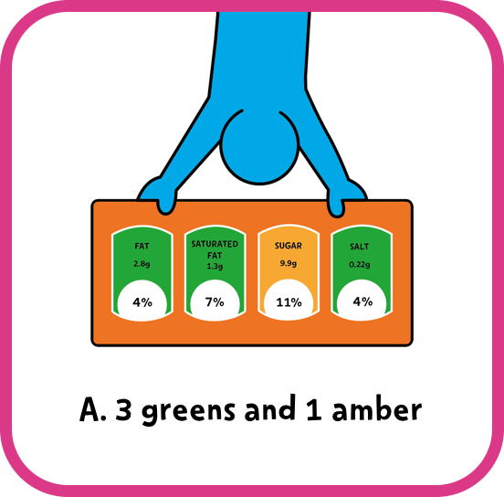
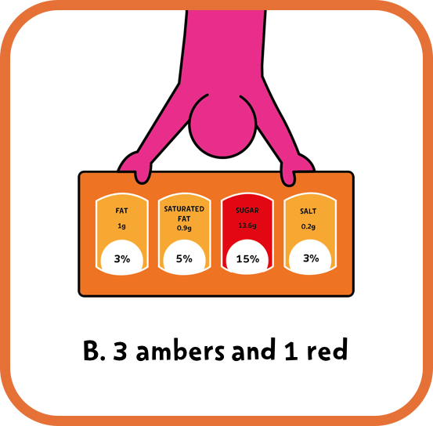
Notes:
Answer: A. 3 greens and 1 amber.
Look for all greens, or greens and ambers on the label. Try to cut down on reds!

Slide 22




Notes:
Answer: A. 2 packaged snacks.
Fruit and veg are the best choices for snacks. If you do choose a packaged snack, aim to have no more than two per day.

Slide 24
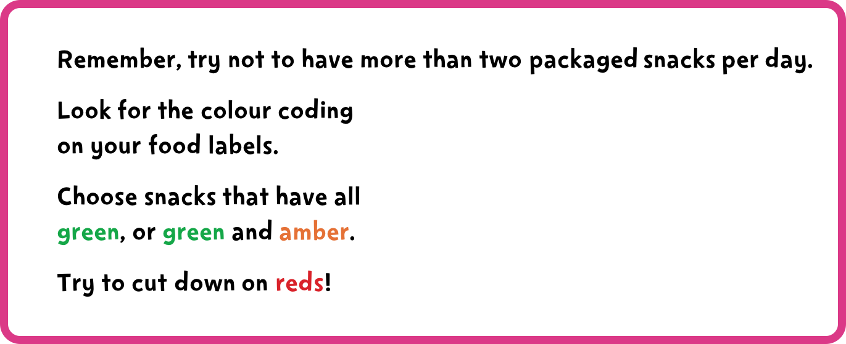
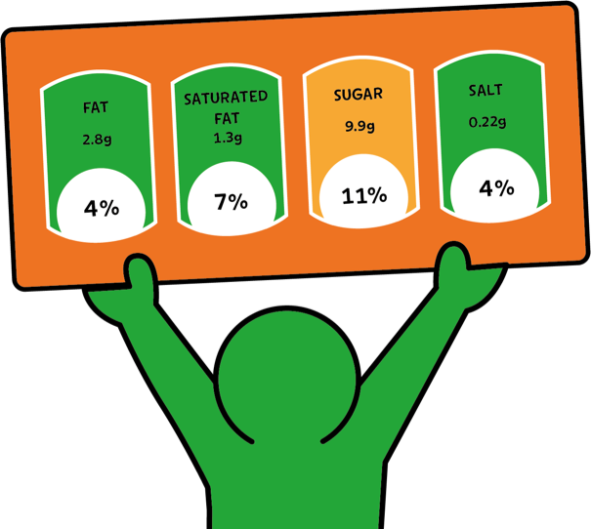
Notes:
This reinforces the key message. You (or your pupils) could ask the audience to remember what colours they should look for on packaged snacks, and what the maximum number of packaged snacks they should have in a day is. Pupils could show the audience examples of snacks that have mostly greens and snacks that have reds on the label.

Slide 25










Slide 26


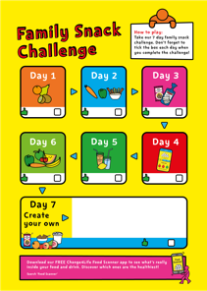


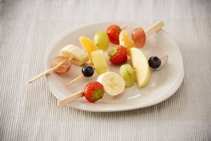
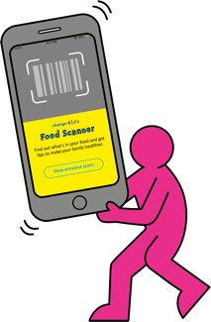


Notes:
If your class has prepared ideas for Day 7 of the Family Snack Challenge, they can present them now.
They can ask the audience to vote on their favourite challenge idea (let parents and carers vote too!).

