Slide 1
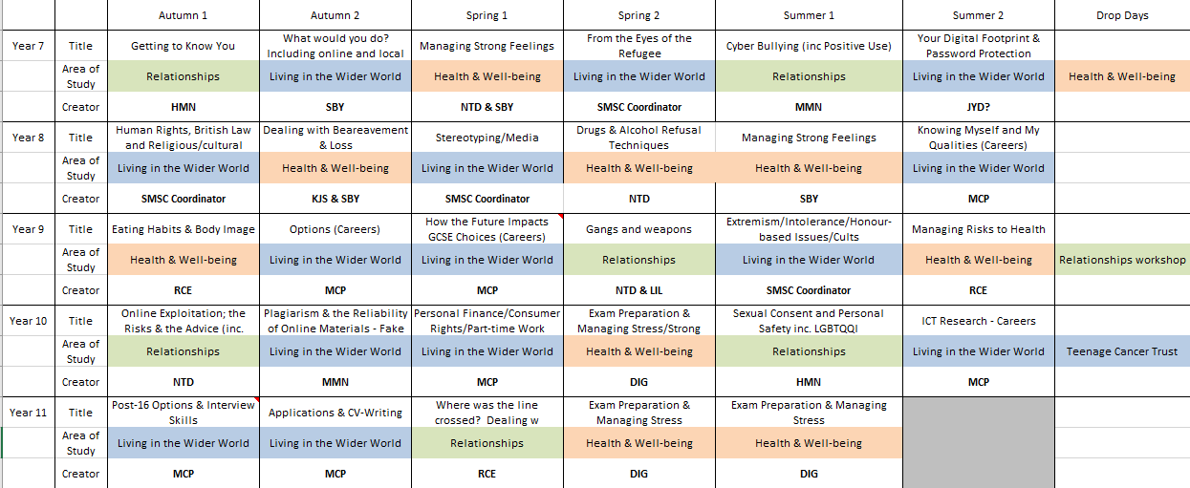
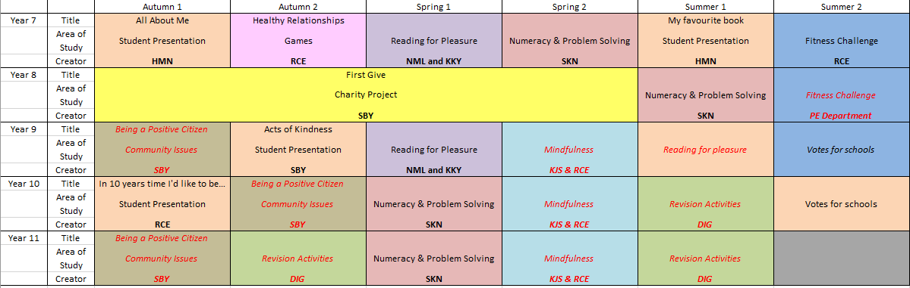
1. Pastoral Curriculum Overview 2018-2019

Slide 2
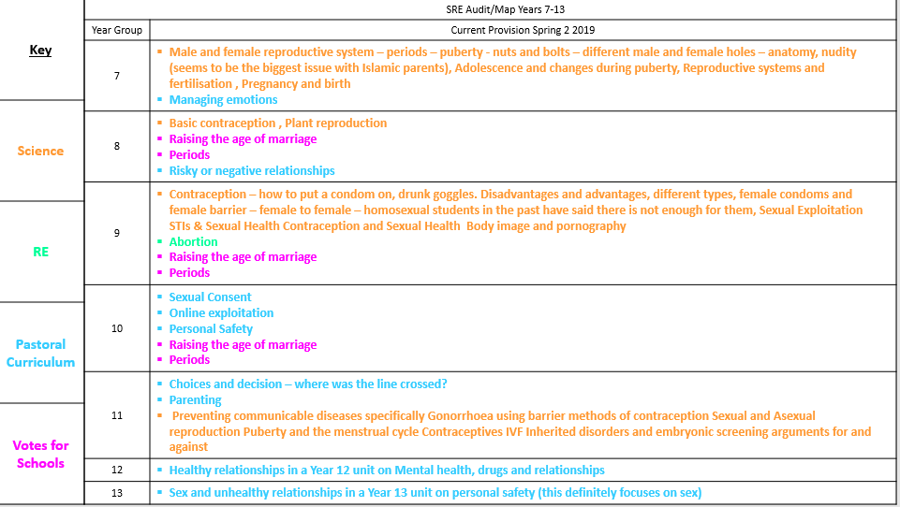
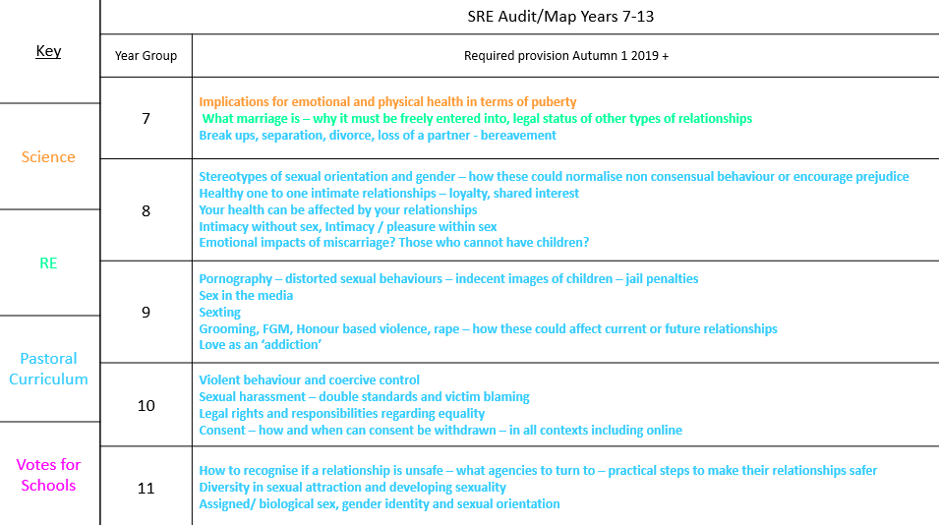
2. SRE Audit 2019 – Whole School
3. SRE Audit 2019 – Whole School plan 2019+ using Statutory Guidance

Slide 3
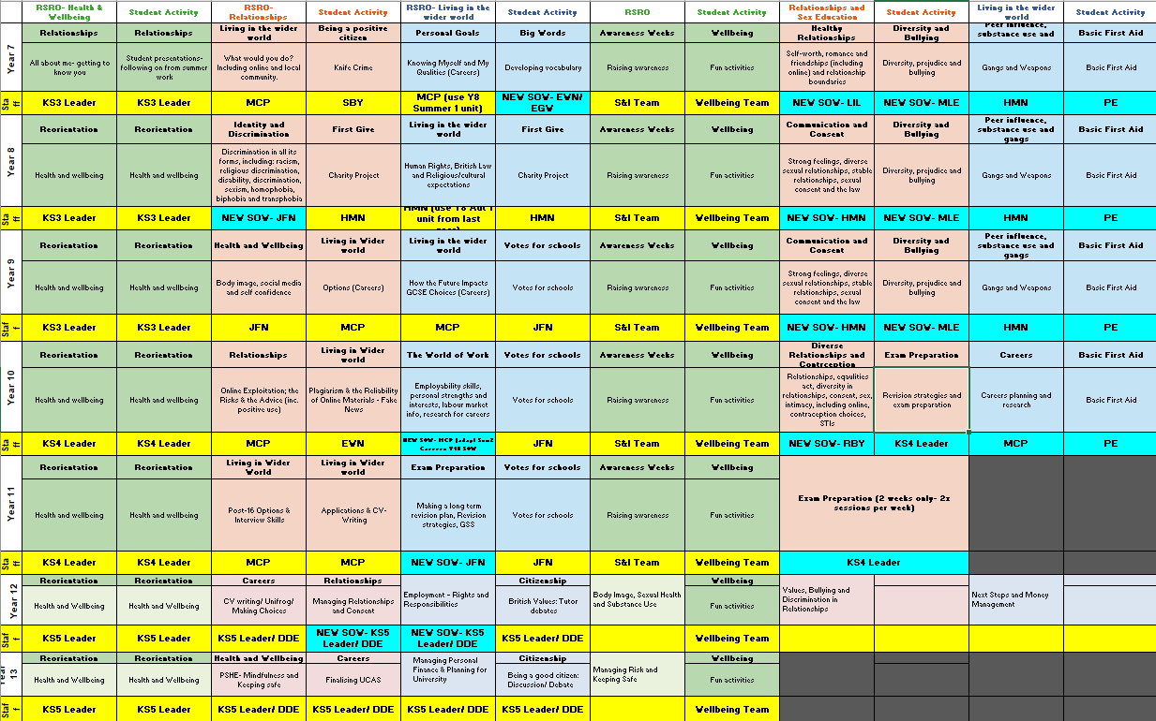
Appendix 4 (Pastoral Curriculum 2020-21)

Slide 4
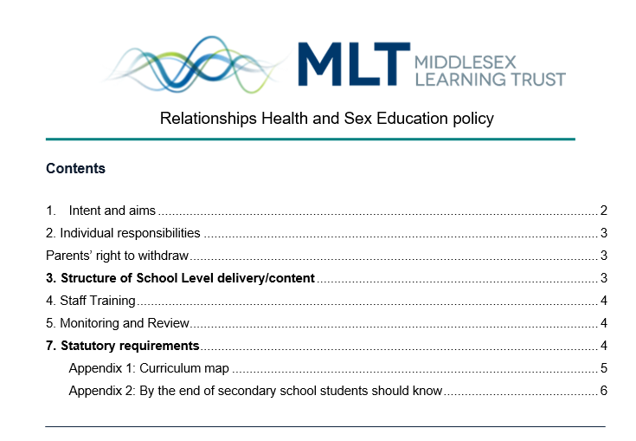
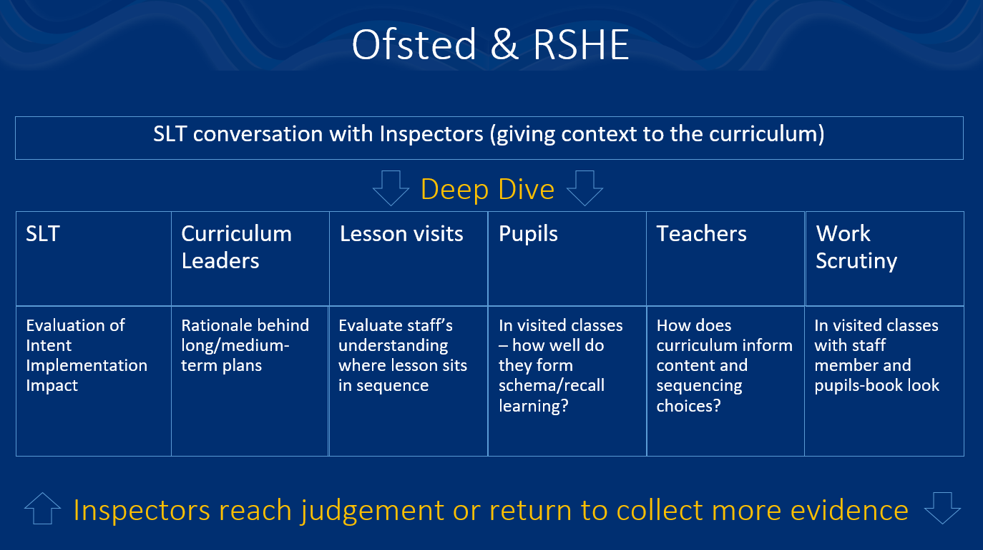
Appendix 5 RSHE School Policy from Sept 2019
Appendix 6 - ‘Ofsted-ready overview’

Slide 5
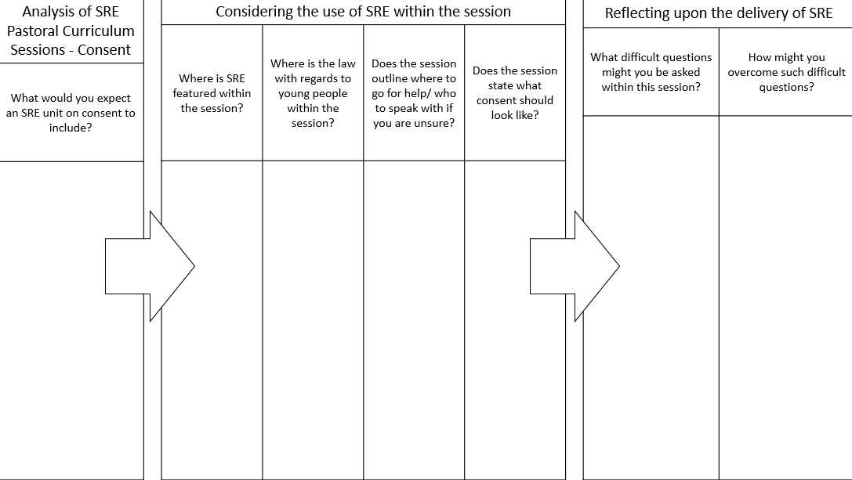
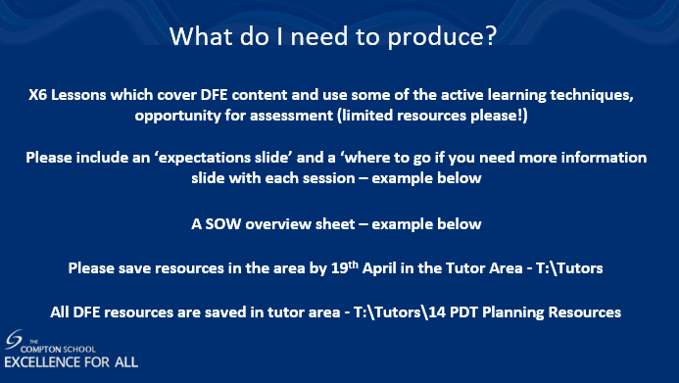
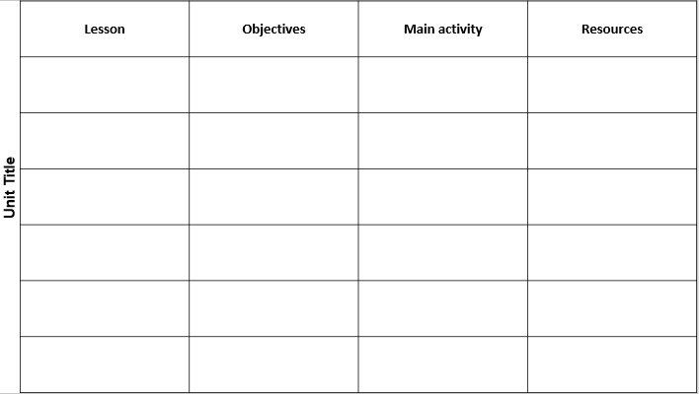
7. SRE CPD for staff – 2020 – Staff analysis of lessons – feedback on Pastoral Curriculum, Staff CPD – 2021 – Training of staff for Pastoral Curriculum SOW creation

Slide 6

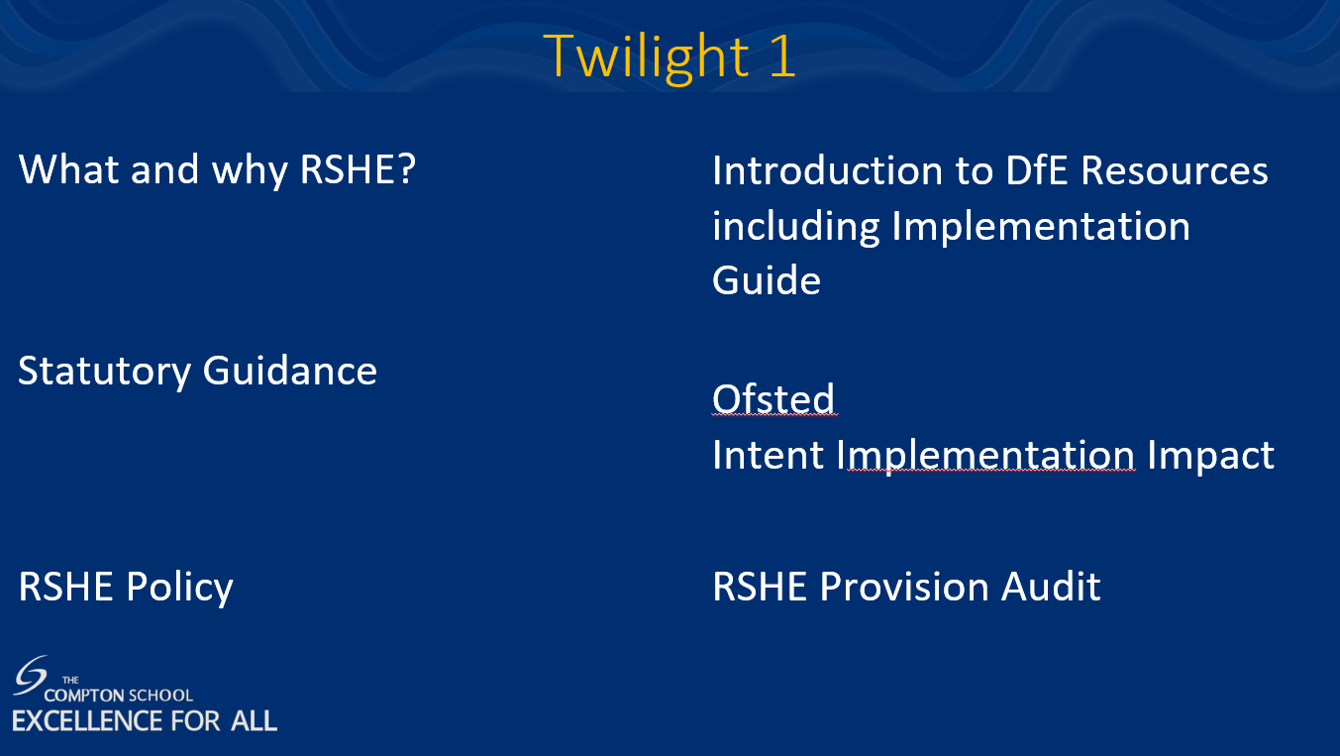

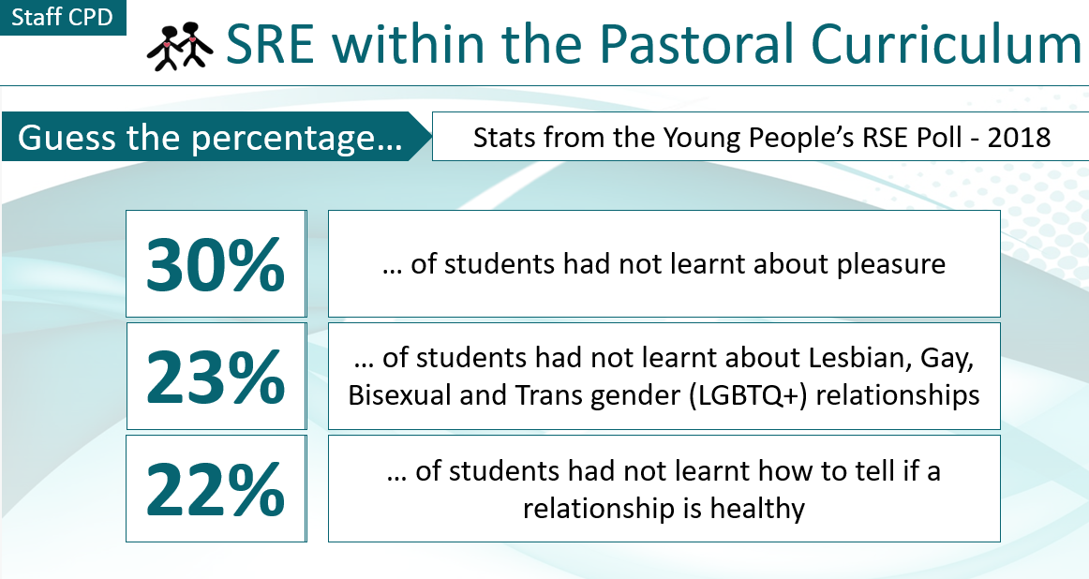
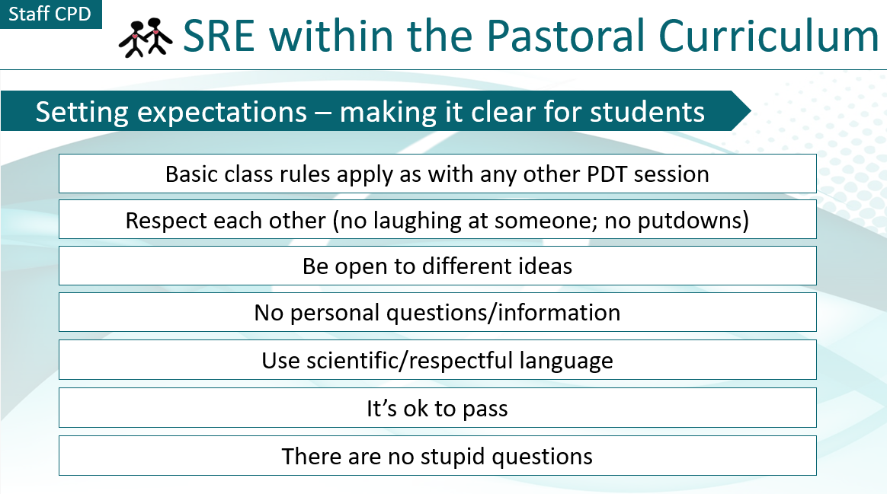
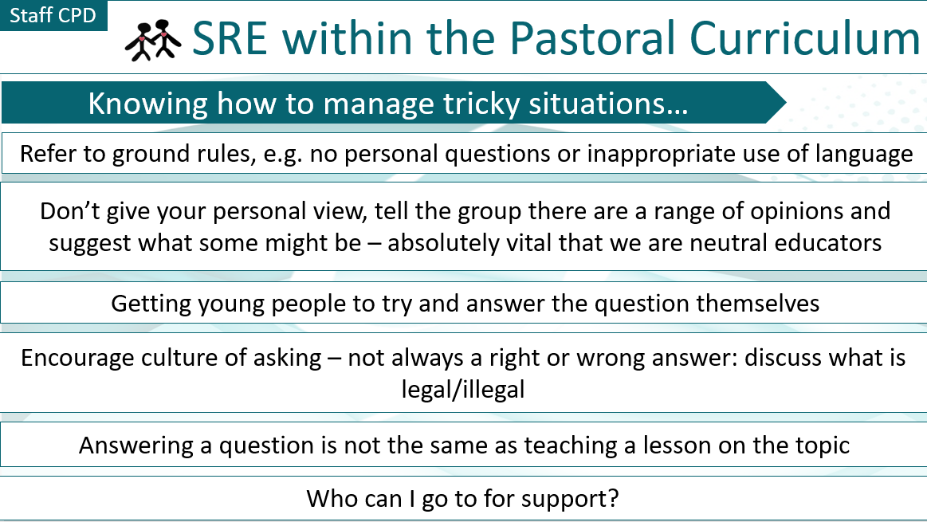
8. DfE RSHE Train the Trainer Programme 2020/21
9. SRE CPD for staff in school, 2020

Slide 7
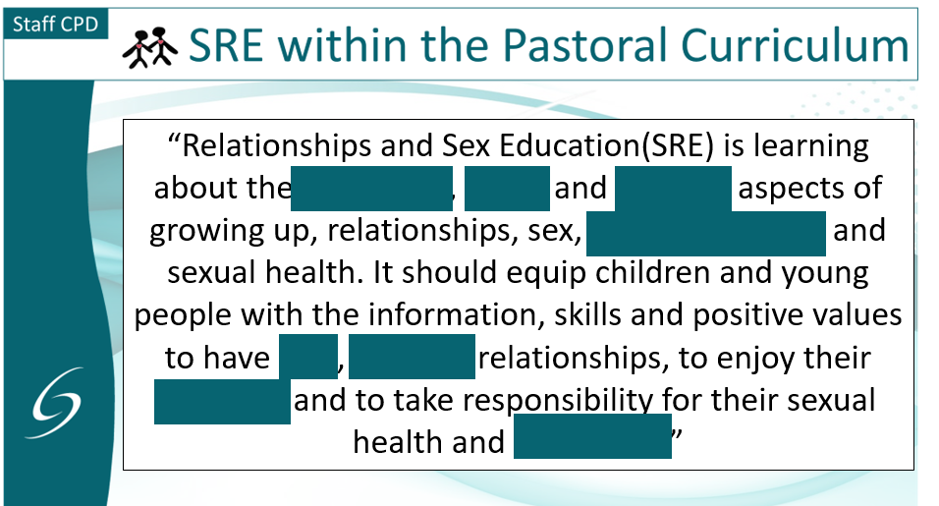
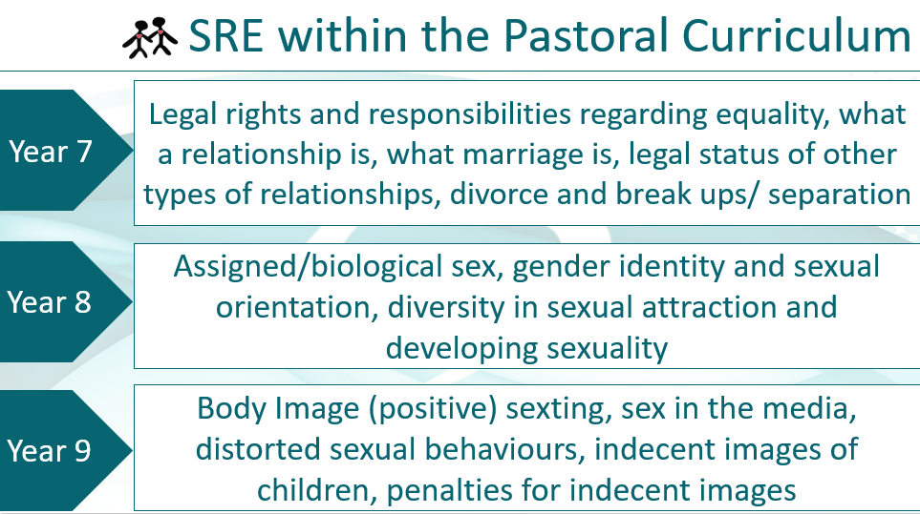
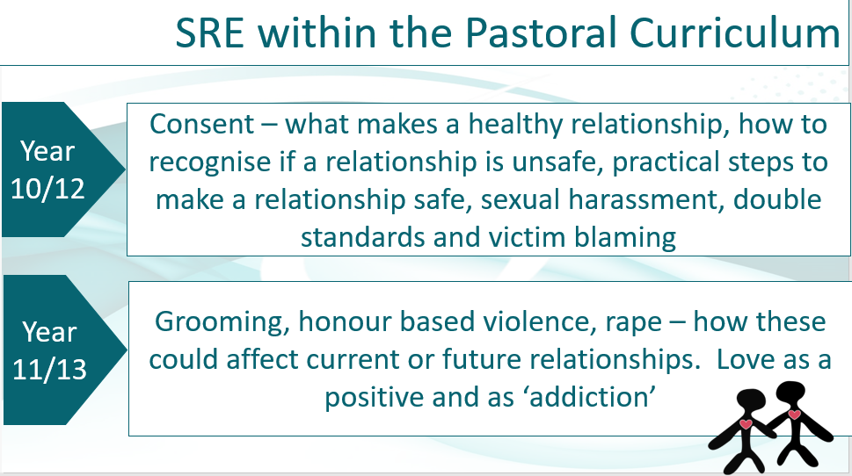


10. SRE CPD for staff - 2019
11. Jan 2019 Neutral Educator CPD for staff

Slide 8



12. Pastoral Curriculum SOW – 2021 - Careers
13. Pastoral Curriculum SOW – 2021 – Knowing Myself
14. Pastoral Curriculum SOW – 2021 – Are Human Rights Universal?

