Slide 1
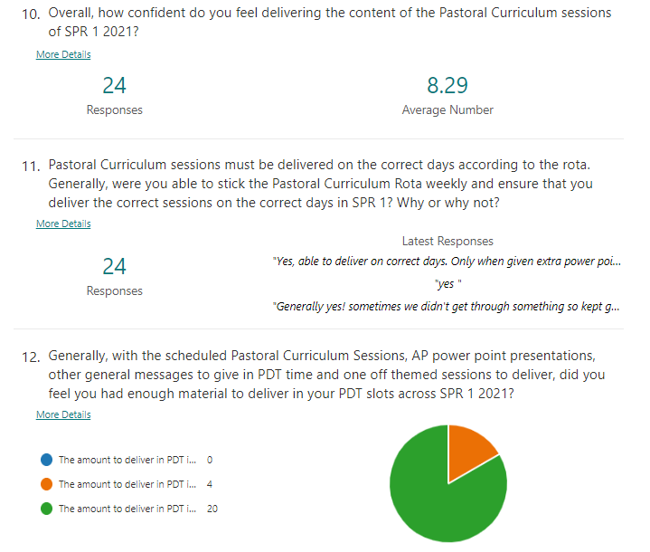
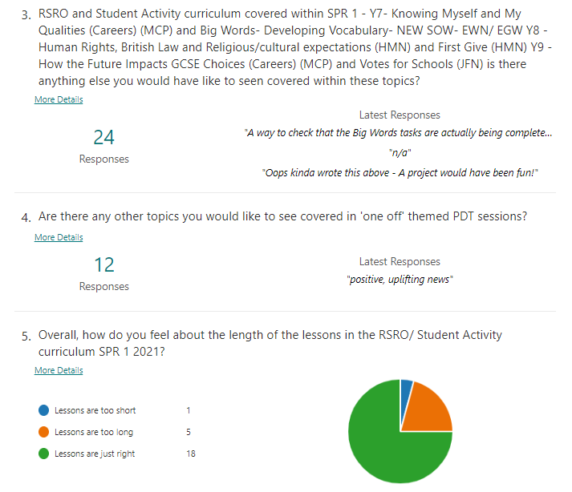
1. Pastoral Curriculum Staff Feedback Spring 2021

Slide 2
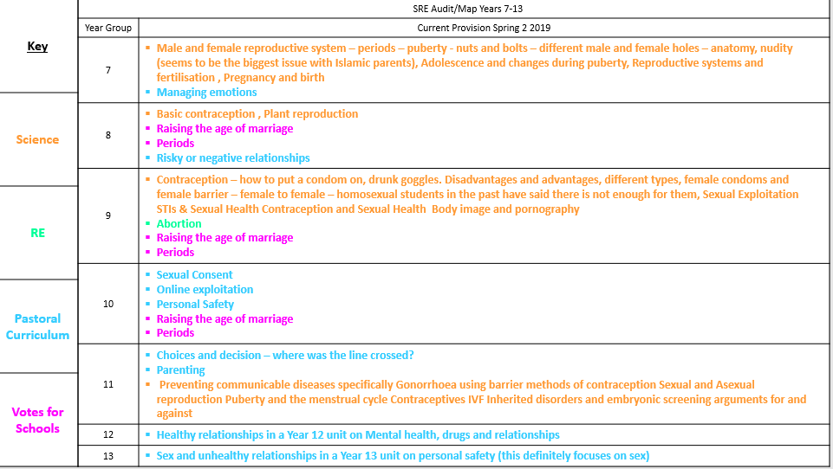
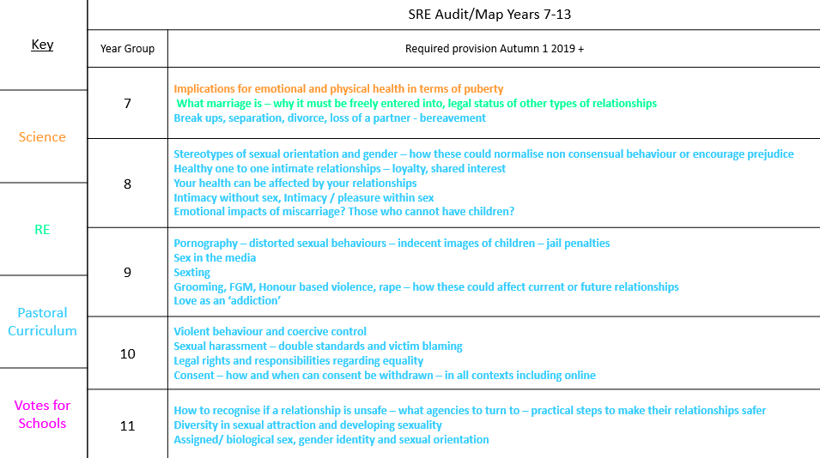
Appendix 2 – Audit of Curriculum - Strengths
Appendix 3 – Audit of Curriculum – Additional Units

Slide 3

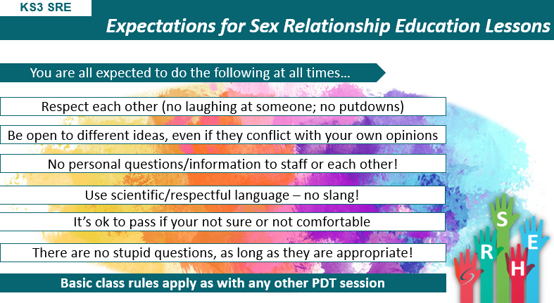
Appendix 4 – Example slides – generic lesson plan

Slide 4
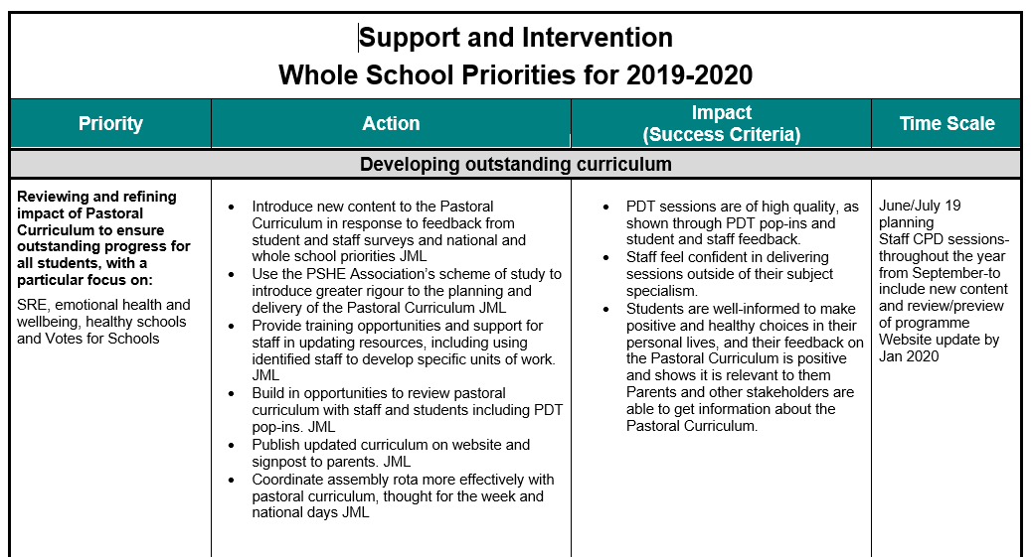
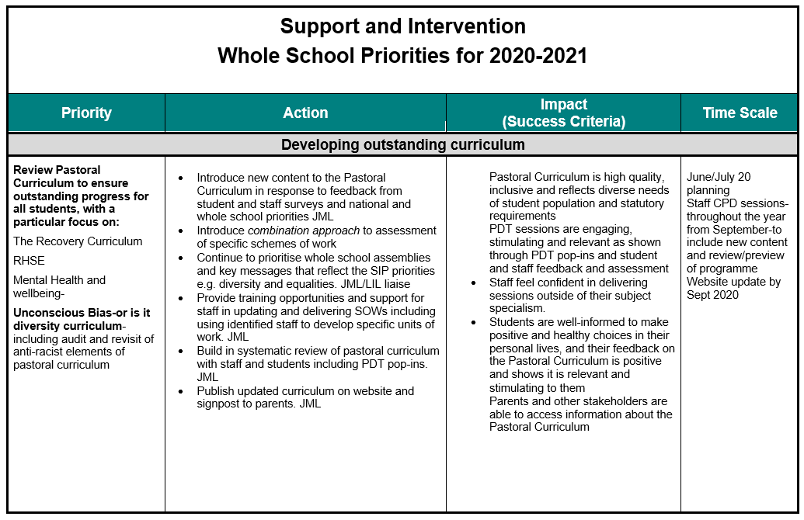
Appendix 5 Support and Intervention Team SIP 2019-20 and 20-21
Appendix 6 Exemplar Year Team training session

Slide 5
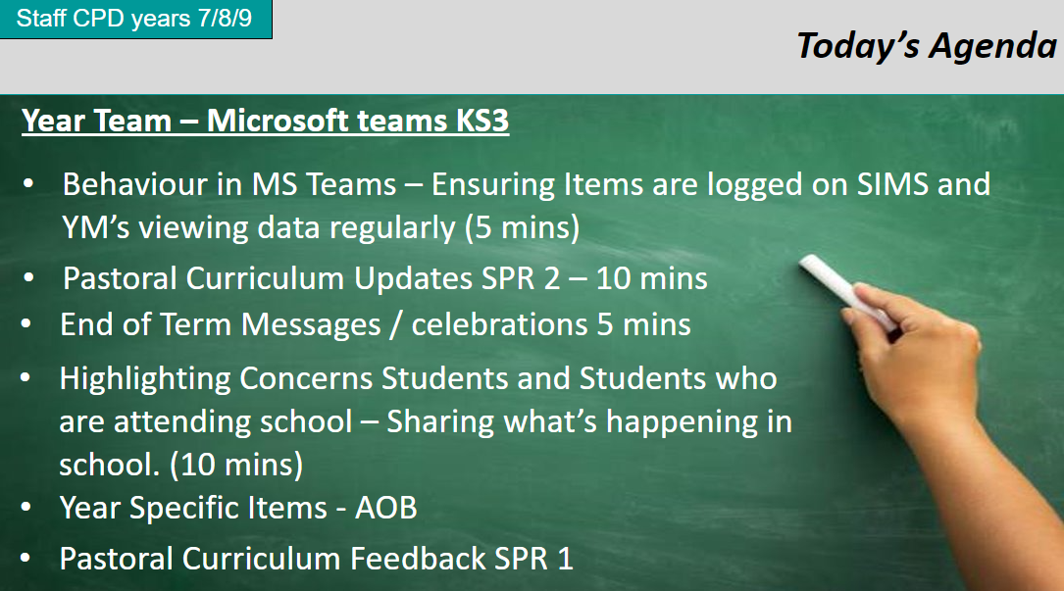
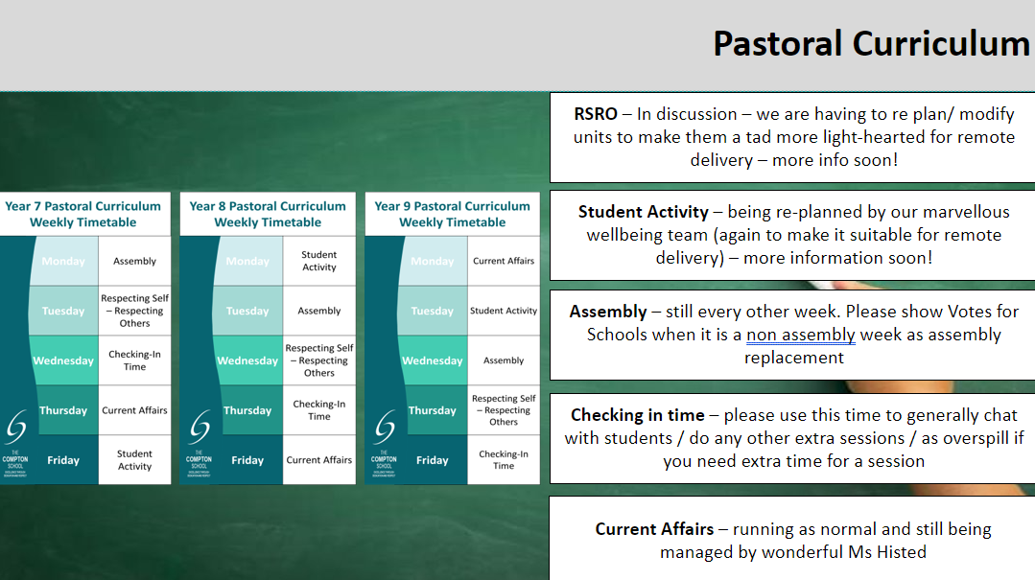
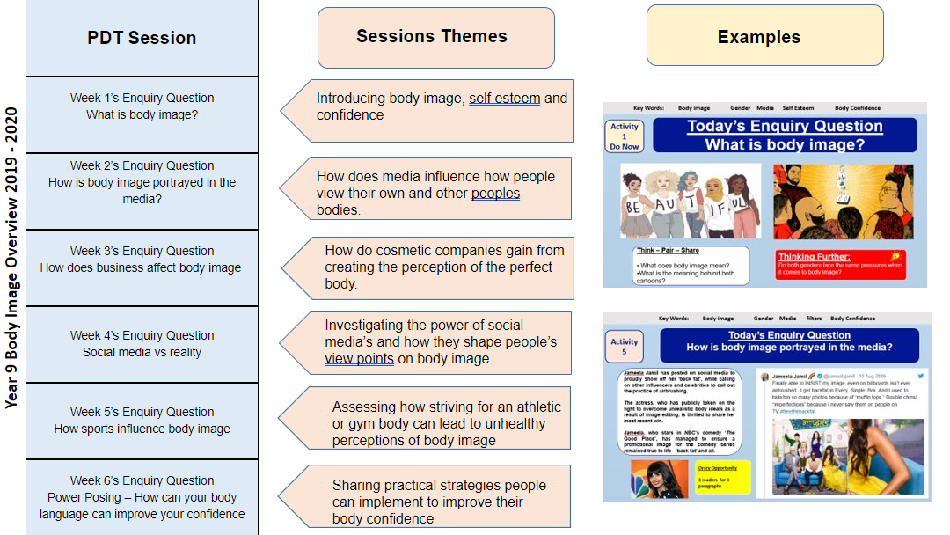
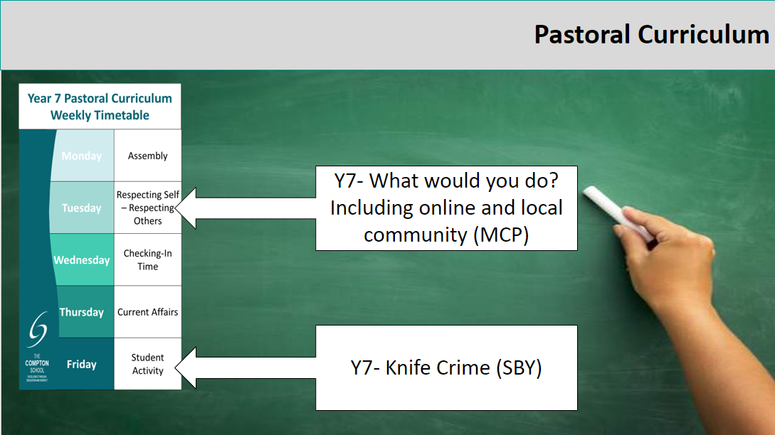

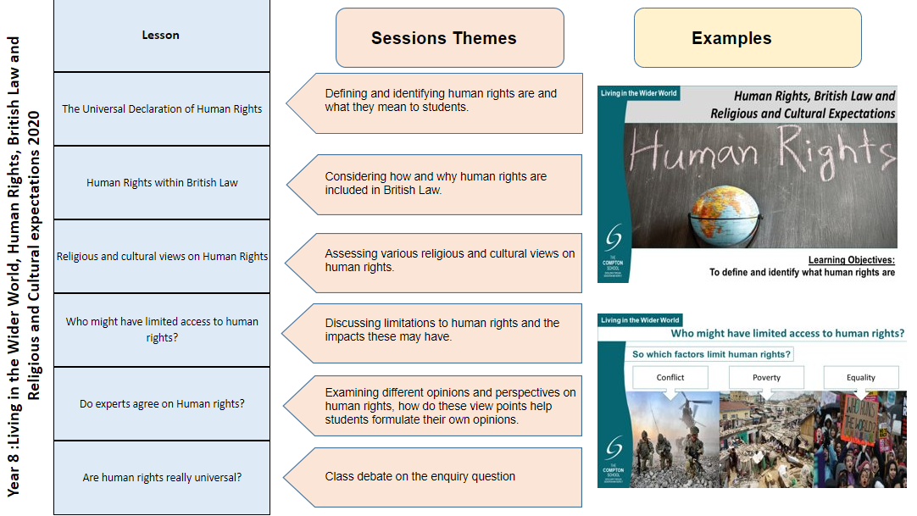
Appendix 7 Exemplar Year Team training session

Slide 6
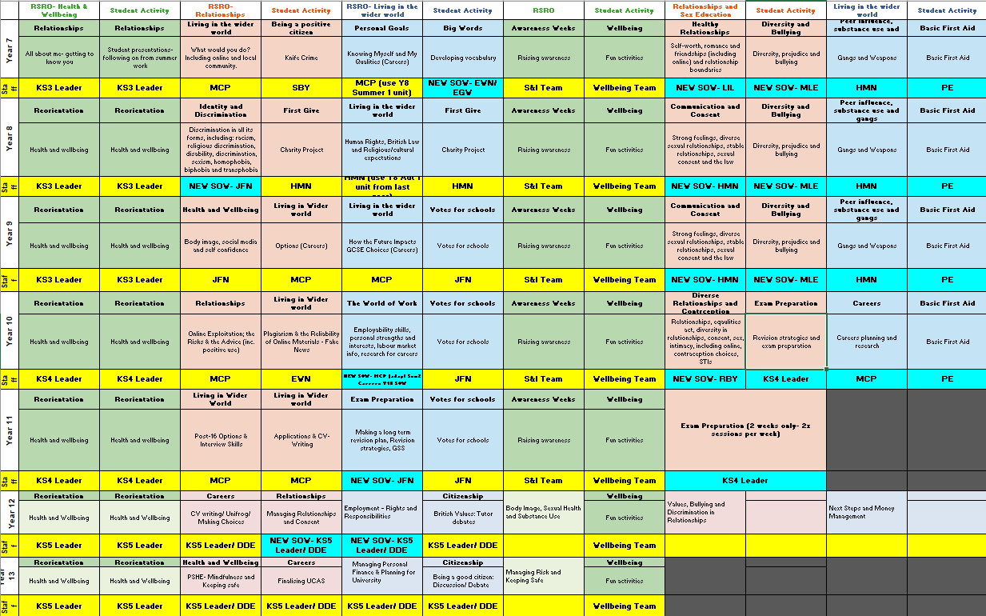
Appendix 8 (Pastoral Curriculum 2020-21)

Slide 7

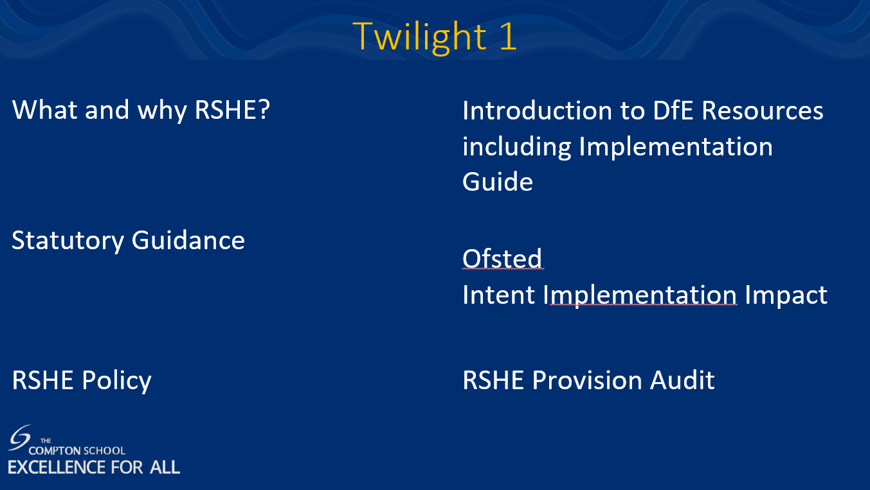

Appendix 9- DfE RSHE Train the Trainer Programme 2020/21

Slide 8
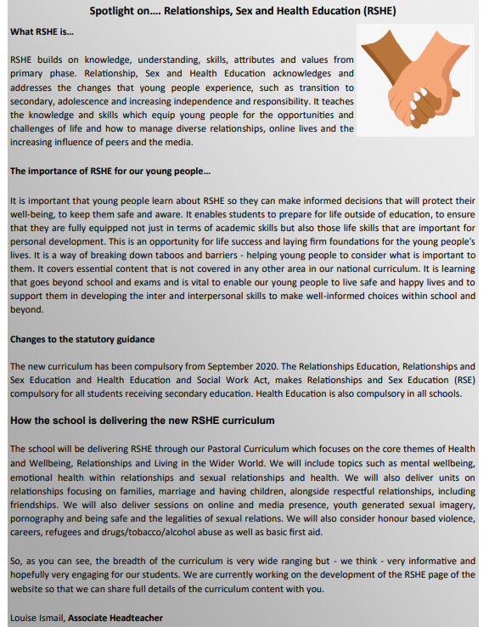
Appendix 10 Newsletter edition 2020-21)

Slide 9
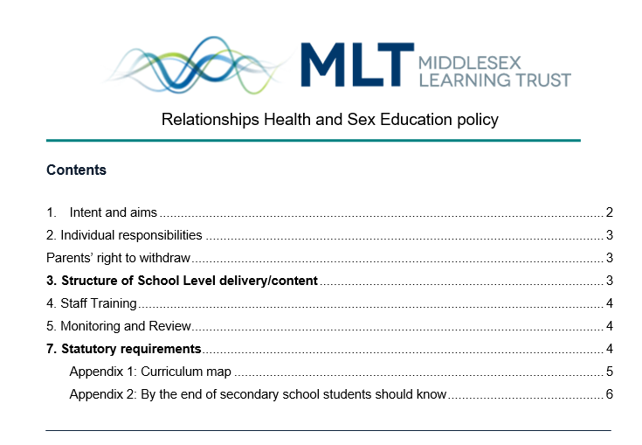
Appendix 11 RSHE School Policy from Sept 2019

Slide 10
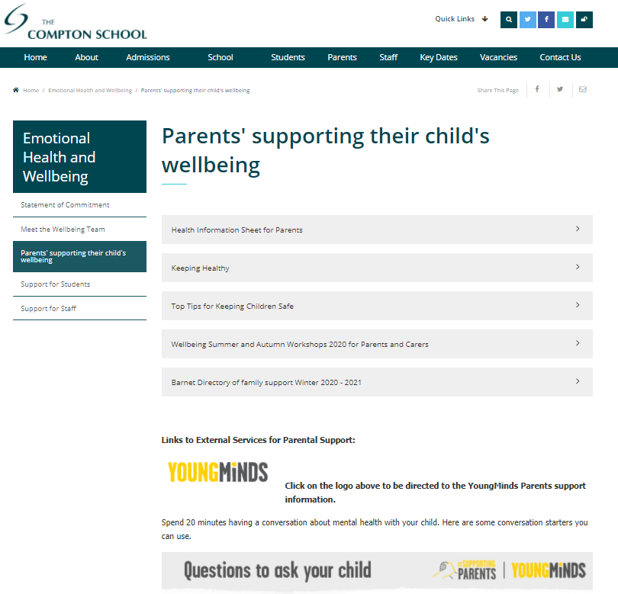
Appendix 12 Wellbeing Support

Slide 11




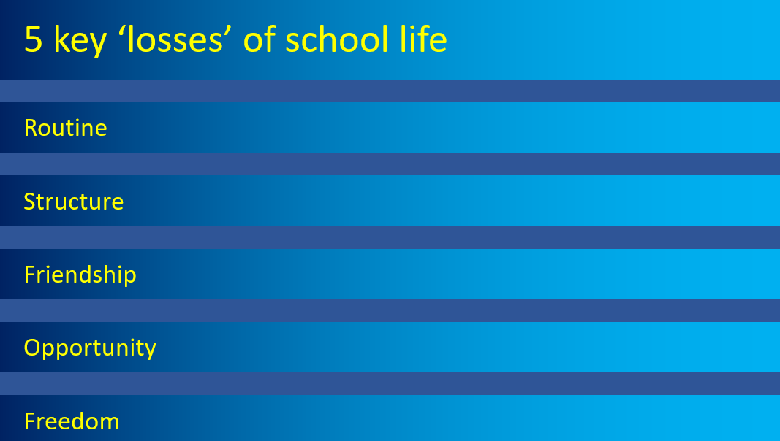

Appendix 13 Kindness Inset/ Safeguarding Inset Watchful Waiting

