Slide 1


Slide 2
Training module
Teaching mental wellbeing
Part of: Health education
Primary

Slide 3
2. Knowledge and capability
From September 2020 there are new requirements for teaching mental wellbeing as part of health education. Statutory guidance explains how this knowledge will benefit pupils.
STATUTORY GUIDANCE
… young people are increasingly experiencing challenges … The new subject content will give them the knowledge and capability to take care of themselves and receive support if problems arise. (p4)

Slide 4
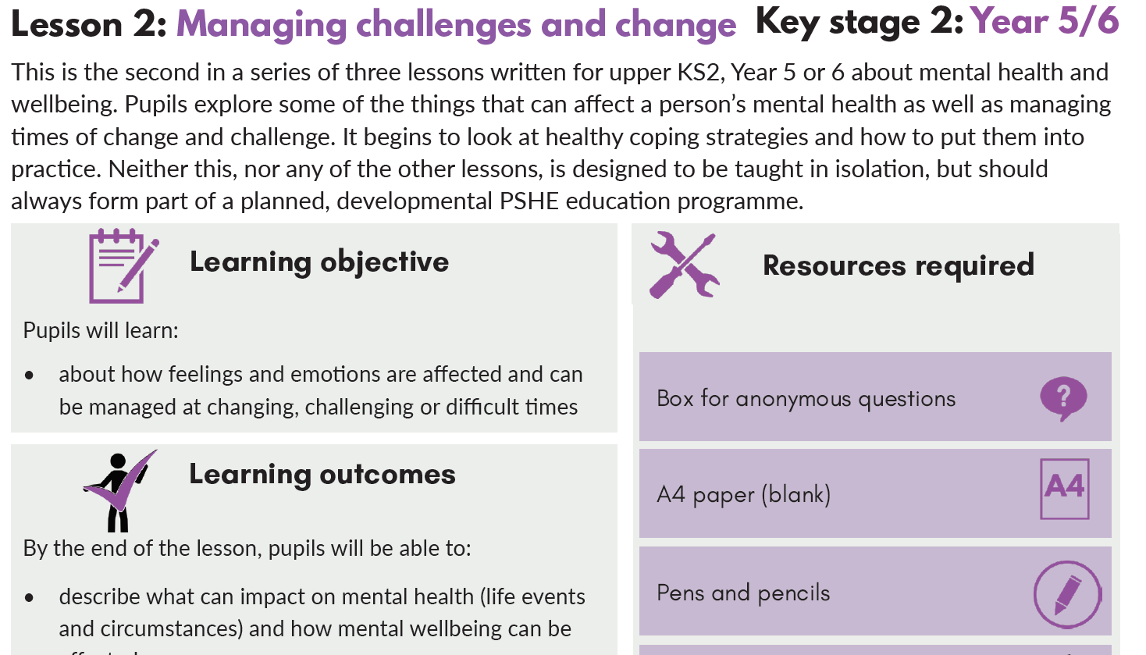
3. Start with wellbeing
The majority of children and young people have good mental wellbeing. The starting point should therefore be teaching pupils the factors that contribute to and help us maintain wellbeing.
Once understanding of wellbeing is established you will be able to teach pupils to understand and identify:
when someone may be experiencing poor mental health
contributing factors to poor mental health
positive strategies to improve wellbeing
when people need help from others

Slide 5
4. Closely related topics
Mental wellbeing is closely related to several other topics such as:
Relationships, bullying, and internet safety and harms
Physical health, healthy eating, and drugs, alcohol and tobacco
Therefore you should:
consider thematic links when planning and delivering lessons
find ways to link knowledge and vocabulary across topics
design lessons that enable pupils to make connections between mental wellbeing and other topics

Slide 6
5.Pupils with SEND
Pupils with special educational needs and disabilities are statistically more likely to have wellbeing needs. Your special educational needs coordinator (SENCO) can help you develop support strategies (this may have happened during curriculum planning).
You will need to adapt lessons to allow all children to access and apply the knowledge in this module, using your expertise as you normally would.
You might want to link lesson outcomes with statutory ‘preparing for adulthood’ outcomes for those with an education, health and care (EHC) plan. (See SEND code of practice, section 8.)

Slide 7
6.Safeguarding
Pupils may be affected by issues discussed in lessons. Let your child protection/pastoral/safeguarding lead know what you are teaching so they can speak to pupils, including those with adverse childhood experiences.
Also make sure you follow safeguarding procedures, including:
setting ground rules for lessons, where needed, particularly around not sharing personal information
stopping discussions if personal information is shared in lessons and following up with pupils later where needed
not promising confidentiality if a pupil confides something concerning
telling pupils they can ask for help and they will be taken seriously

Slide 8

7.Create class ground rules
Clear class ground rules can help when teaching about sensitive topics. They also support confidentiality and safeguarding of pupils.
Good practice is for ground rules to be:
discussed and understood by all
clear and practical
modelled by the teacher
followed consistently and enforced
updated when needed
visible in lessons (for example, posters)
Children can ask questions – there are no ‘stupid questions’

Slide 9
8. Example ground rules
Respect privacy. We can discuss examples but don’t use names or descriptions that identify anyone, including ourselves. We never put anyone ‘on the spot’.
Listen to others. It’s okay to challenge a view or disagree, but we listen properly before making assumptions or deciding how to respond. Everyone has the right to feel listened to.
No judgement. We can explore beliefs and misunderstandings about a topic without fear of being judged.
Right to pass. Every pupil has the right to choose not to answer a question or join the discussion if a topic makes them uncomfortable.

Slide 10

Primary curriculum
You may also want to refer to the statutory guidance for physical health and mental wellbeing.
Physical health and mental wellbeing are interlinked, and it is important that pupils understand that good physical health contributes to good mental wellbeing, and vice versa.
It is important for schools to promote pupils’ self-control and ability to self-regulate, and strategies for doing so. This will enable them to become confident in their ability to achieve well and persevere even when they encounter setbacks or when their goals are distant, and to respond calmly and rationally to setbacks and challenges. This integrated, whole-school approach to the teaching and promotion of health and wellbeing has a potential positive impact on behaviour and attainment.

Slide 11
10. Introducing mental wellbeing
STATUTORY GUIDANCE
Know mental wellbeing is a normal part of daily life, in the same way as physical health.
Teach pupils that, like physical health, mental wellbeing is an important part of daily life that is influenced by different factors, including exercise.
Explain to younger pupils that things they value, enjoy or are good at can all support mental wellbeing. Positive relationships, and eating and sleeping well can also help.
Prompt older pupils to reflect on ways they can contribute to others’ mental wellbeing, and establish which activities help them maintain their own wellbeing.
Reference: NHS: 5 steps to mental wellbeing
TEACHING POINTS
Common factors for wellbeing
Individual preferences
Self-care
Primary

Slide 12

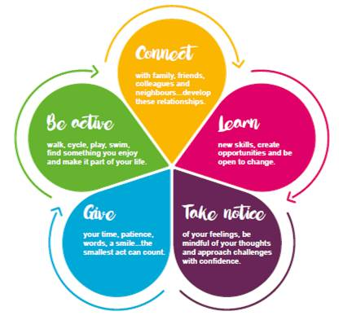

Slide 13
11. Range of childhood emotions
STATUTORY GUIDANCE
Know there is a normal range of emotions (e.g. happiness, sadness, anger, fear, surprise, nervousness) and scale of emotions that all humans experience in relation to different experiences and situations.
Teach pupils to identify and name the range and degrees of emotions in daily life. Pitch lessons to match developmental stage:
Stage 1: Recognising fear, joy, disgust, surprise, sadness, anger, happiness.
Stage 2: Recognising pride, shame, dismay, jealousy, embarrassment, empathy.
Stage 3: Recognising multiple emotions (feeling good, bad or indifferent at the same time), false emotions (pretending to like a present).
TEACHING POINTS
Advanced vocabulary
Self-expression
New concepts
Primary

Slide 14
12.Scale of childhood emotions
STATUTORY GUIDANCE
Know there is a normal range of emotions (e.g. happiness, sadness, anger, fear, surprise, nervousness) and scale of emotions that all humans experience in relation to different experiences and situations.
Teach younger pupils to recognise:
emotional triggers (losing a toy, routine change)
that the behaviour of others can affect their wellbeing
their own behaviour and emotions can affect others
Build older pupils’ awareness of:
the impact of life events (parents separating, arrival of a new sibling)
the many factors that can affect mood such as responsibilities, personal preferences, exercise
how events can affect the intensity of our emotions
TEACHING POINTS
Self-awareness
Empathy
Emotions
Primary

Slide 15
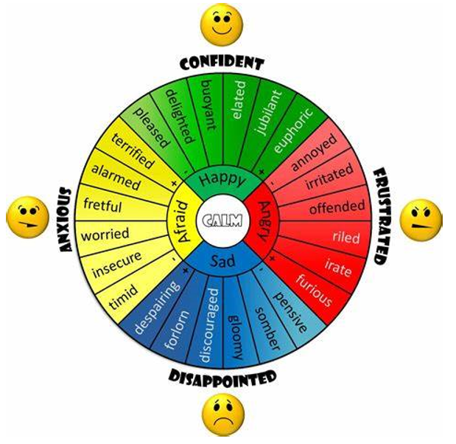
13.Talking about emotions
STATUTORY GUIDANCE
Know how to recognise and talk about emotions, including having a varied vocabulary of words to use when talking about their own and others’ feelings.
Establish and build younger pupils’ vocabulary for:
things that make them feel happy or sad
things that could make someone else feel happy
Challenge older pupils to talk in more complex and nuanced ways about:
how events and people can make them feel happy, sad, anxious or upset
others’ emotions and how to recognise them
how someone might feel in an abstract scenario
TEACHING POINTS
Advanced vocabulary
Self-expression
Positive relationships
Empathy
Primary

Slide 16
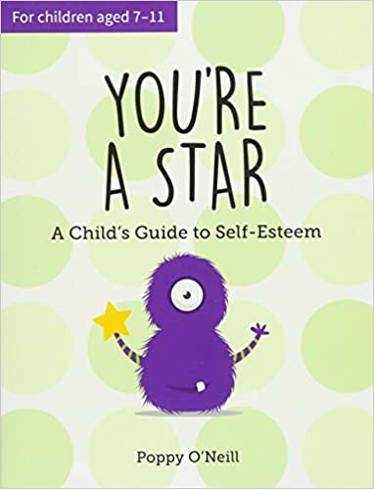




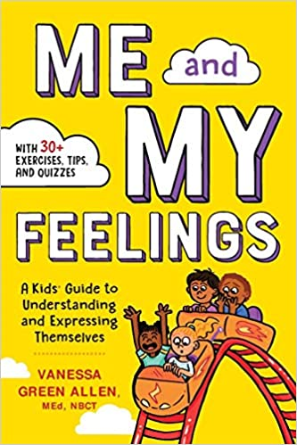




Slide 17
14. Appropriate emotions / behaviour
For younger pupils model appropriate:
responses to events/situations
ways to express emotions
Also provide opportunities for pupils to practise recognising appropriate emotions and behaviour.
Give older pupils opportunities to select appropriate emotions and behaviours in response to (positive or negative) scenario-based triggers. Teach that there is usually a range of potential responses / expected behaviours.
STATUTORY GUIDANCE
Know how to judge whether what they are feeling and how they are behaving is appropriate and proportionate.
TEACHING POINTS
Recognise triggers
Choose/moderate own behaviour
Primary

Slide 18
15. Positive factors for mental wellbeing
STATUTORY GUIDANCE
Know the benefits of physical exercise, time outdoors, community participation, voluntary and service-based activity on mental wellbeing and happiness.
Teach and remind pupils of proven positive factors for mental wellbeing:
physical exercise - activity that gets heart pumping
time outdoors - sports, play, gardening
community participation - clubs and hobbies
voluntary activity - in class, home or elsewhere
positive routines - including around sleep
Teach pupils that people need to ration/limit time spent online (including mobile phones) as too much time online can have a negative effect on wellbeing.
TEACHING POINTS
Wellbeing factors
Online harms
Primary

Slide 19
16. Simple self-care techniques
STATUTORY GUIDANCE
Know simple self-care techniques, including the importance of rest, time spent with friends and family and the benefits of hobbies and interests.
Teach younger pupils to make positive connections between things they enjoy (activities, friends) and feeling good.
Challenge older pupils to reflect on how rest, time with others, hobbies and interests, rationing time online, help to maintain and increase their wellbeing.
Ensure older pupils are taught and know of a range of self-care strategies they can use to regulate their emotional experience (for example, some people enjoy mindfulness, colouring, exercise, setting a time to ‘unwind’ before bed as well as getting enough sleep).
TEACHING POINTS
Wellbeing factors
Self-care techniques
Primary

Slide 20


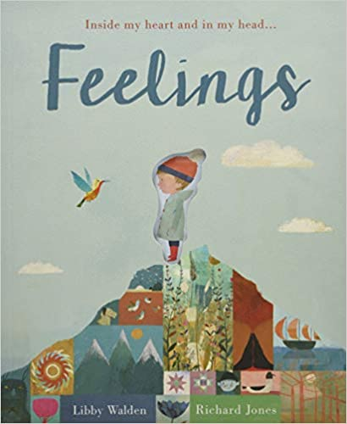
17. Isolation and loneliness
STATUTORY GUIDANCE
Know isolation and loneliness can affect children and that it is very important for children to discuss their feelings with an adult and seek support.
Teach pupils the difference between boredom, isolation and loneliness. Anyone (including adults) can experience these feelings – whether or not they have people with them.
Encourage younger pupils to use creative activities (such as telling or writing stories) to tackle boredom.
Emphasise that they can seek out a trusted adult or friend when they feel lonely. Explore strategies with older pupils to reduce loneliness (for example, seeking companionship or joining clubs).
TEACHING POINTS
Self-care strategies
Reducing loneliness
Primary

Slide 21
18. Talking and getting support
STATUTORY GUIDANCE
Know isolation and loneliness can affect children and that it is very important for children to discuss their feelings with an adult and seek support.
Remind younger pupils to talk to a trusted adult when:
experiencing friendship problems (e.g. toys being taken from them)
they feel lonely
Check that older pupils:
can describe what loneliness is
know that it can help to talk about feelings
are aware of the adults they can talk to
can suggest actions a character might take if they were lonely (structured scenario)
TEACHING POINTS
Asking for support
Talking about feelings
Dealing with emotions
Primary

Slide 22
19. The impact of bullying
STATUTORY GUIDANCE Know that bullying (including cyberbullying) has a negative and often lasting impact on mental wellbeing.
Teach that:
bullying can make people feel bad and negatively affects mental wellbeing
all types of bullying can hurt people (including ‘cyberbullying’)
you can’t always tell if someone is being hurt by bullying
bullying can affect someone long after an incident has happened (it can affect their whole life)
Emphasise that bullying should not be tolerated and that people should ask for help if they need it.
TEACHING POINTS
Understanding bullying
Empathy
Primary

Slide 23
20. When to ask for help
STATUTORY GUIDANCE Know where and how to seek support (including recognising the triggers for seeking support)...
Tell younger pupils that they should always ask for help when they need it, such as when they or someone else is worried or upset.
Explain and encourage older pupils to recognise scenarios when they should ask for help, such as when they’re concerned about:
their wellbeing / emotional reactions
someone else’s wellbeing / emotional reactions
This could be in response to face-to-face or online behaviour.
TEACHING POINTS
Asking for support
Self-awareness
Primary

Slide 24
21. Who to ask for help
STATUTORY GUIDANCE Know … whom in school they should speak to if they are worried about their own or someone else’s mental wellbeing or ability to control their emotions (including issues arising online).
Ensure all pupils know their appropriate adults to ask for support when they or somebody else is feeling hurt, upset, worried or angry (including about issues arising online).
Identify their key trusted adults at school and remind pupils they can also talk to any other teacher.
Older pupils should also know who they can speak to outside school (e.g. parent/carer, a friend).
TEACHING POINTS
Knowing who to talk to
Self-awareness
Primary

Slide 25
22. Children and mental health
STATUTORY GUIDANCE
Know it is common for people to experience mental ill health. For many people who do, the problems can be resolved if the right support is made available, especially if accessed early enough.
Teach pupils that feeling emotions such as sadness doesn’t mean we are unwell - feelings often change throughout the day and over longer periods.
Sometimes mental wellbeing can be affected, e.g. by life events or seemingly lower-level stressors and:
people sometimes need help to get better or cope, e.g. help from family, friends, a doctor
wellbeing is a spectrum and addressing issues early can minimise the negative impact
people can seem happy but still need help
TEACHING POINTS
When we need help
Benefit of getting help early
Primary

Slide 26
By the end of primary pupils should know:
that mental wellbeing is a normal part of daily life, in the same way as physical health
that there is a normal range of emotions and scale of emotions in relation to different experiences and situations
how to recognise and talk about their emotions (varied vocabulary when talking about their own and others’ feelings)
where and how to seek support it is common for people to experience mental ill health. Problems can mostly be resolved if the right support is made available/early enough

Slide 27
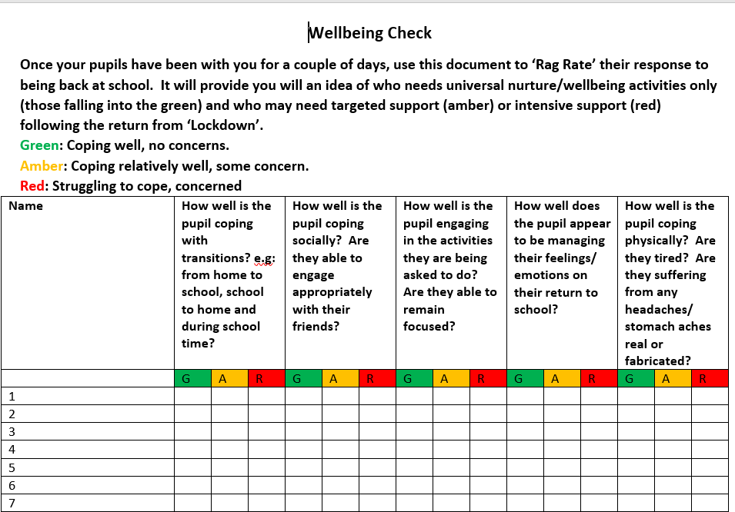
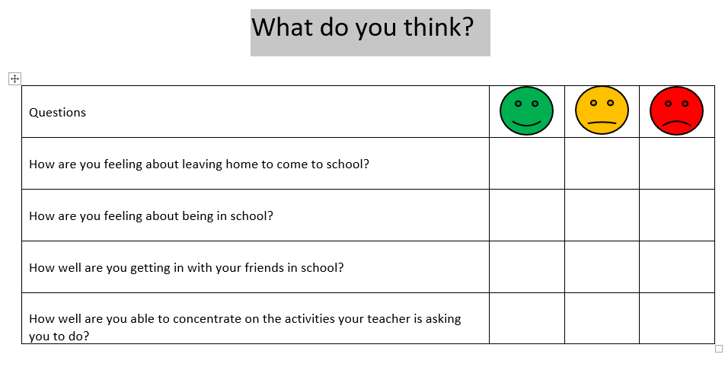

Slide 28
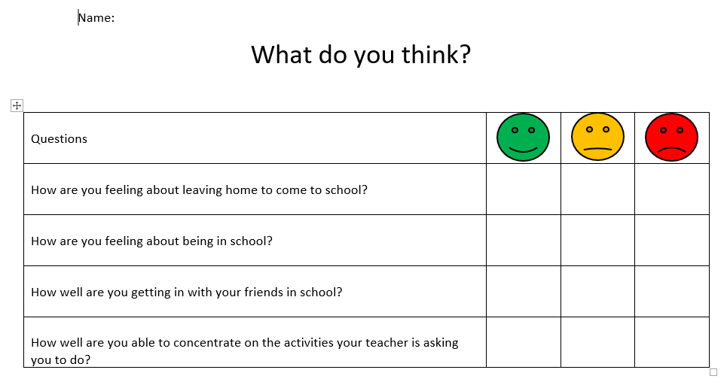
24. Planning wellbeing teaching
Approaches to consider:
ensure pupils know that they can talk to their teacher or other trusted adults if they have any concerns about wellbeing
consider giving pupils contextual information (e.g. through a virtual learning environment) ahead of lessons where appropriate
begin and end classes on a positive and let pupils know a few minutes before class will end to allow them to transition
think about the atmosphere in the teaching space (seating arrangements, relevant posters)
Good practice

Slide 29
25. Mediated self-monitoring
Embed ‘early signs’ of wellbeing concerns and encourage self-monitoring through third-person scenarios that challenge pupils to articulate their knowledge. This is emotionally safer than roleplay and avoids pupils ‘oversharing’ or being singled out.
How does someone know when they are well?
What do people notice when their wellbeing isn’t right?
How would someone know if their wellbeing changed?
How do people behave when they are not well?
When might someone need support from others?
Who might be able to give support?
Good practice

Slide 30

26. Share further information
Make sure pupils know the key people they can speak to at school, and that if they want to they can speak to any teacher.
You could also make information about support organisations available in the classroom and school spaces. For example:
Childline - where children can get in touch on 0800 1111
Young Minds - crisis helpline
GP and other health professionals
In an emergency or crisis pupils should also know they can contact the Samaritans or call 999.
Good practice

Slide 31
Dealing with difficult questions (1)
What would you say?
What wouldn’t you say?
[Prepare ‘difficult’ questions to discuss in training or give teachers a blank version to fill with their own Qs]
Follow up
How could this have been prevented?

Slide 32
Dealing with difficult questions (2)
Pupils may well ask questions because they:
want information
are seeking permission - “Is it OK if I …?”
are trying to shock
have related personal beliefs
Remember:
don’t feel pressured or that you have to answer straight away
don’t disclose personal information - use third-person examples, say ‘some people...’
seek advice if you need it

Slide 33
Mental wellbeing spectrum
When teaching pupils about mental wellbeing it can helpful to convey that wellbeing is a spectrum rather than binary (good, bad).
Healthy
Coping
Struggling
Unwell
CAN BE USED AS A VISUAL AID IN TEACHER TRAINING - NOT SUGGESTED AS A CLASSROOM RESOURCE

Slide 34
Rate your confidence (before and after training)
How do you feel about teaching this topic?
Not confident at all
Very confident
1 | 2 | 3 | 4 | 5 | 6 | 7 | 8 | 9 | 10

Slide 35
Template for Mental wellbeing support at [school name]
Our leads
[Names, contact details of child protection, wellbeing, pastoral, designated mental health leads]
Our policies
[Add details - e.g. school policy on PSHE, training opportunities]
Specialist support
[Add details - e.g. local authority, CAMHS, charities]
Other information
[Add resources]

Slide 36
Training module
Teaching about the changing adolescent body
Part of: Physical health and mental wellbeing
Upcoming recorded training module
Primary

Slide 37
Q & A
Tracy Okuma
RSE/PSHE Lead
Surrey South Farnham Teaching School
rshe@sfet.org.uk

